Slide 1
Plumbing 101

Slide 2
Becoming a Plumber & Plumbing Fields
Want to be a Plumber:
https://www.youtube.com/watch?v=QHJaa8KlGMM
Apprenticing to be a plumber
https://www.youtube.com/watch?v=kBdrzCrKE6U

Slide 3
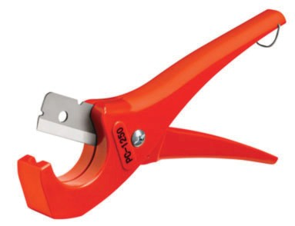
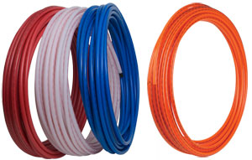
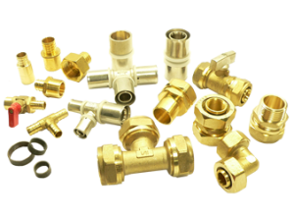
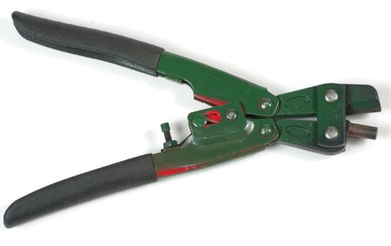
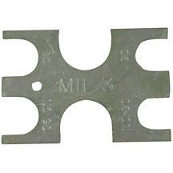
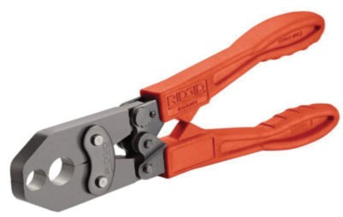
PEX Plumbing
PEX (or crosslinked polyethylene) is part of a water supply piping system that has several advantages over metal pipe (copper, iron, lead) or rigid plastic pipe (PVC, CPVC, ABS) systems. It is flexible, resistant to scale and chlorine, doesn't corrode or develop pinholes, is faster to install than metal or rigid plastic, and has fewer connections and fittings.
http://www.pexinfo.com/

Slide 4
PEX Pipe and Crimping Tools
Crimping Tool:
Store with jaws closed.
Keep clean of dirt and oil.
Ensure correct engagement of crimp ring by use of go/no go gauge.
Plastic tube cutter:
should be kept in a closed position when not in use. The blades are extremely sharp.

Slide 5
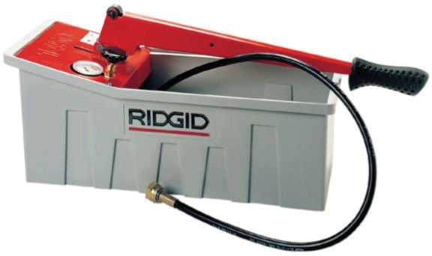
PEX Pipe and Crimping Tools
Go/No go gauge:
A go/no go gauge is used to determine the correct engagement of a crimp ring.
Water pump pliers:
commonly used for turning & holding nuts & bolts, gripping irregularly shaped objects, holding pipes etc. They hold all kinds of items with larger diameter too, regardless of whether they are round, square or hexagonal.
Hydrostatic pump:
tests hydraulically for leaks in installations that are required to be leak proof

Slide 6
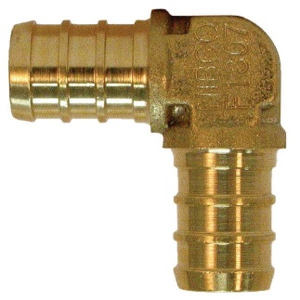
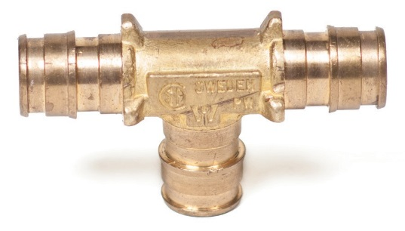
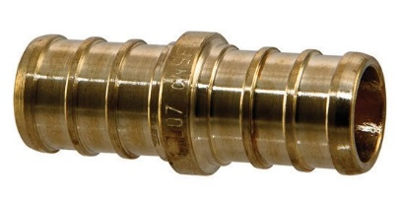
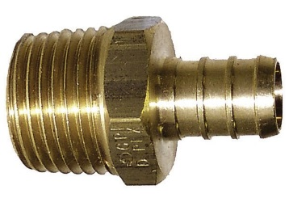
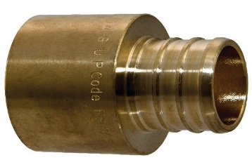
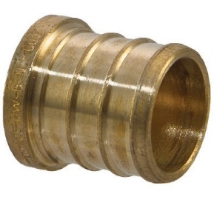
PEX Pipe, Crimps and Fittings
½” crimp 90° elbow used to make a sharp change of direction
½” crimp tee used to connect three pieces of pipe
½” coupling used to connect two pieces of pipe
½” PEX or crimp by external (male) thread. This adapter can be used to connect PEX piping systems to a threaded internal (female) fitting.
½” crimp adapter to solder fitting* used to connect a soldered copper pipe to PEX
½” crimp plug used at outlets to cap piping

Slide 7
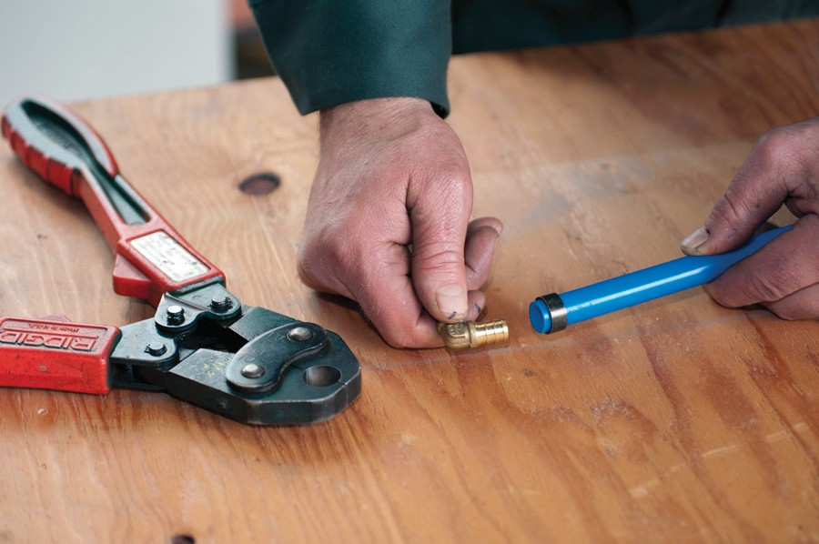
Assembly Demonstration
Cut the PEX pipe to length. It is important that piping is cut squarely.
Slip an unused crimp ring over the end of the pipe.
Fully insert the crimp fitting.
Slide the crimp ring in a distance of ⅛”–¼” from the end of the pipe.
Squeeze the crimp ring with water pump pliers to hold it in place

Slide 8
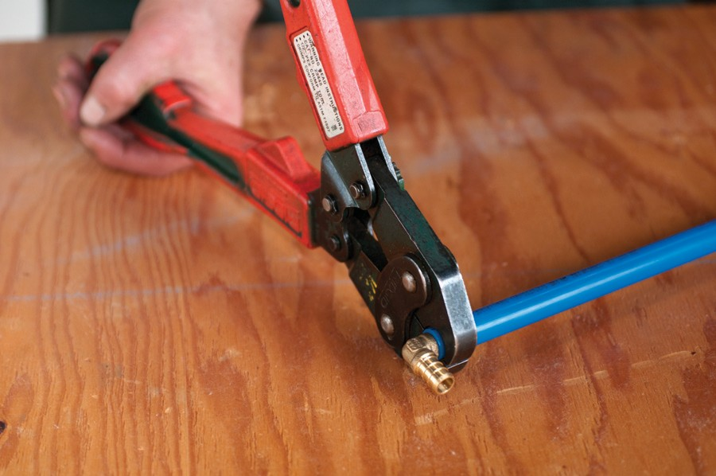
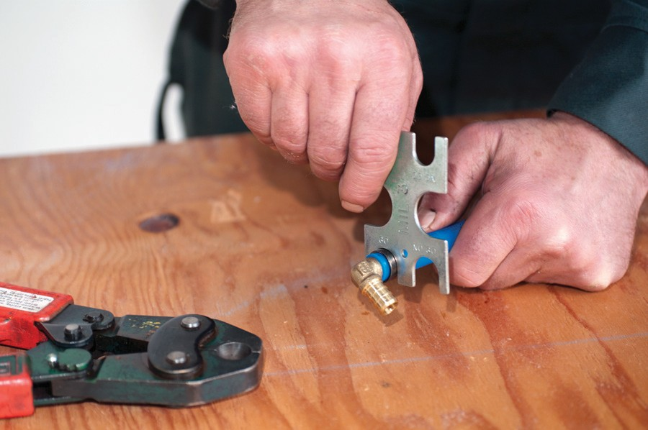
Assembly Demonstration Con’t
Use the crimping tool
Squeeze until fully closed
Use the go/no go gauge to test if the Crimping Tool is set correctly.

Slide 9
Disassembly Demonstration
Remove any pressure from within the pipe.
Cut the pipe approximately ¾" back from its end.
Use crimp ring cutter to cut the ring.
The cut ring should be recycled (copper is valuable).
The small piece of pipe goes into the garbage.
Longer pieces of pipe can be stored for future use.
Fittings should be returned to their correct storage location

