Slide 1
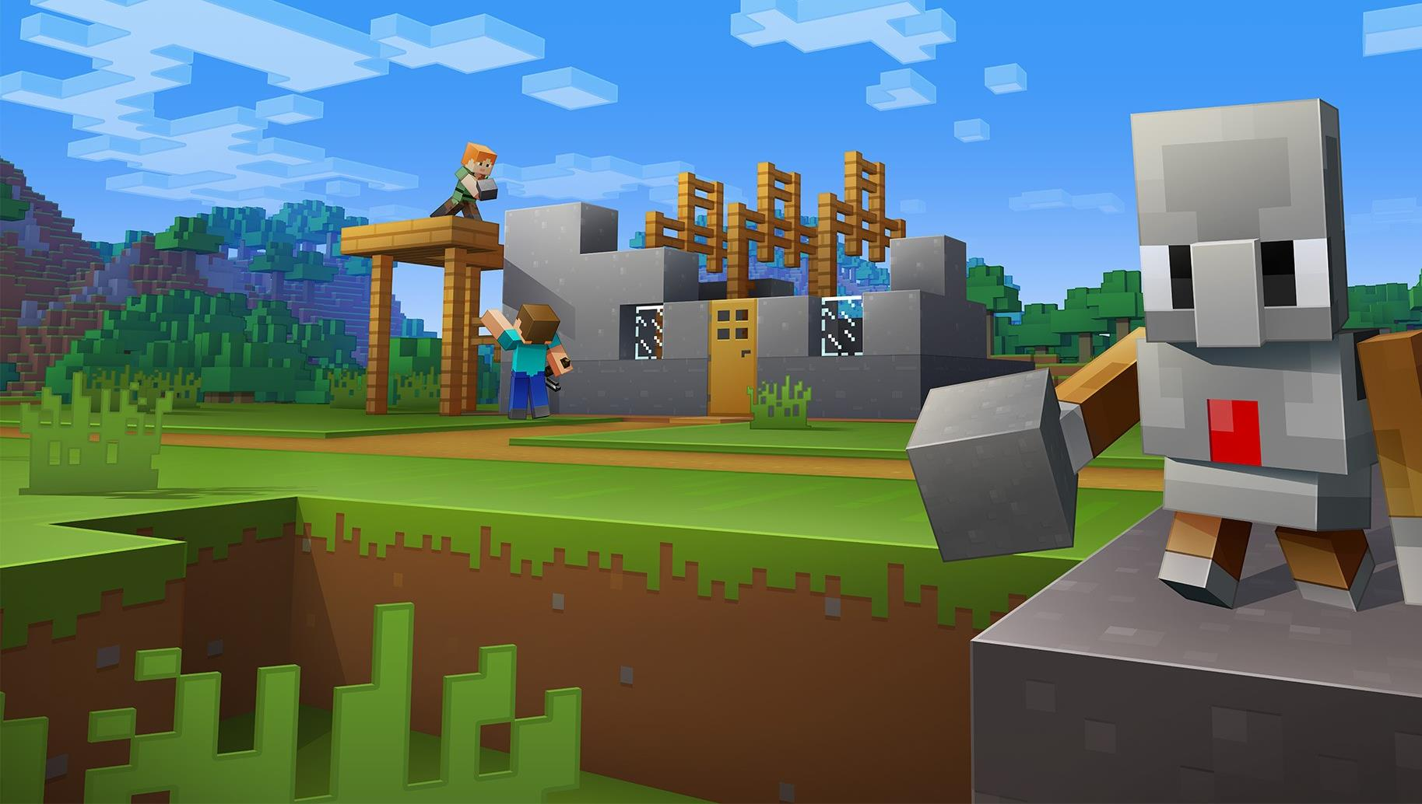
CyberSafe: Home Sweet Hmm Safer Internet & Digital Identity
STOP and THINK…BEFORE YOU CLICK!

Slide 2
I will identify how people use Internet in their everyday lives.
I will stay safer on the Internet and avoid common online risks by stopping and thinking, before clicking on anything.
I will protect my personal information.
I will ask for help from trusted adults when I feel unsure or uncomfortable.
What we will learn Today?

Slide 3
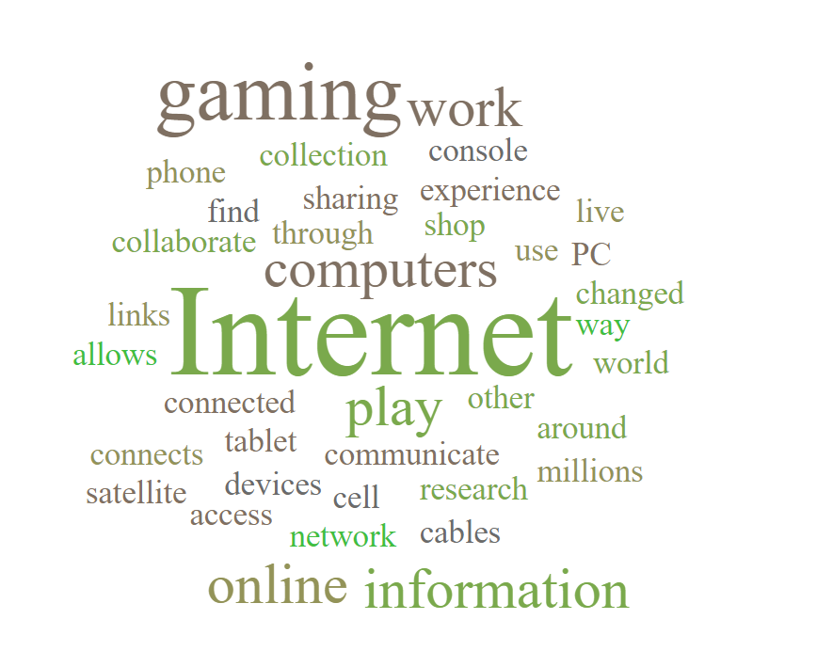
What is the Internet?

Slide 4
The Internet has changed the way we live, work, and play.

Slide 5
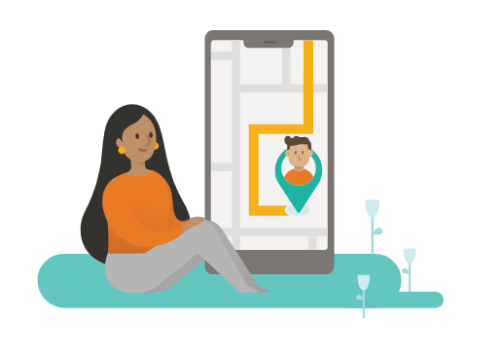
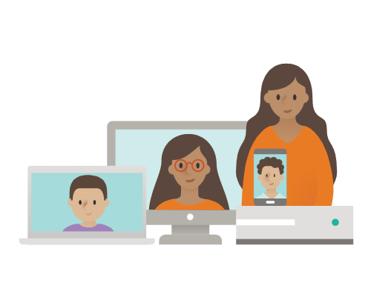
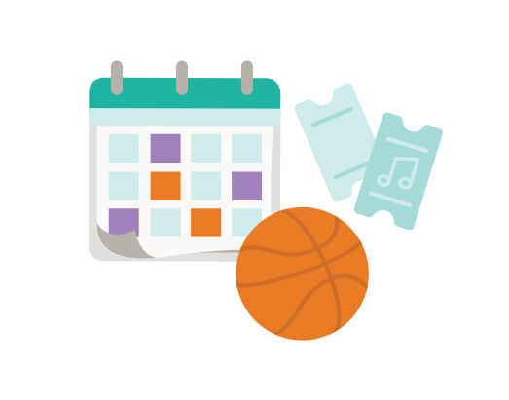
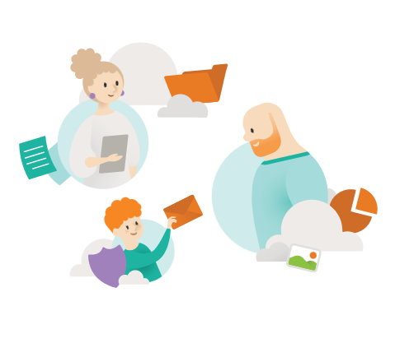
How has the Internet changed the everyday tasks in our lives?

Slide 6
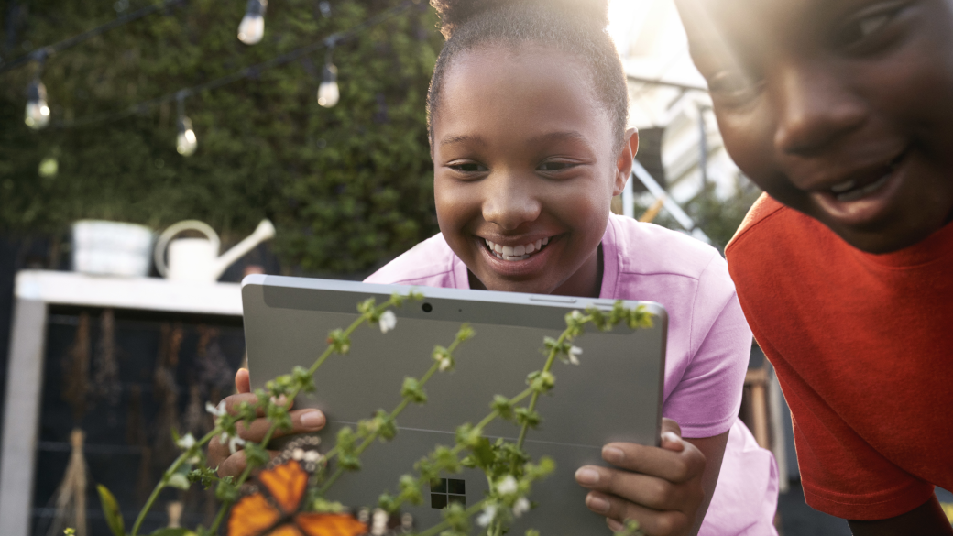
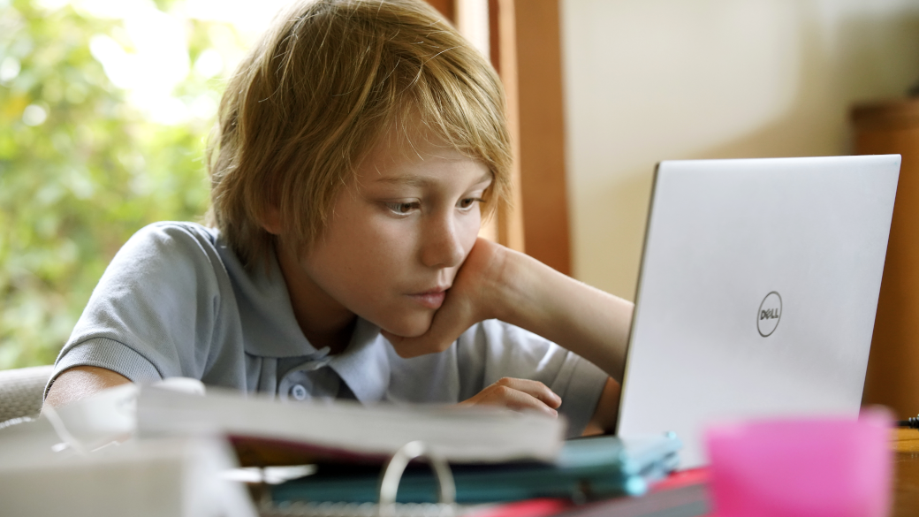
What does it mean to “stay safe online”?

Slide 7
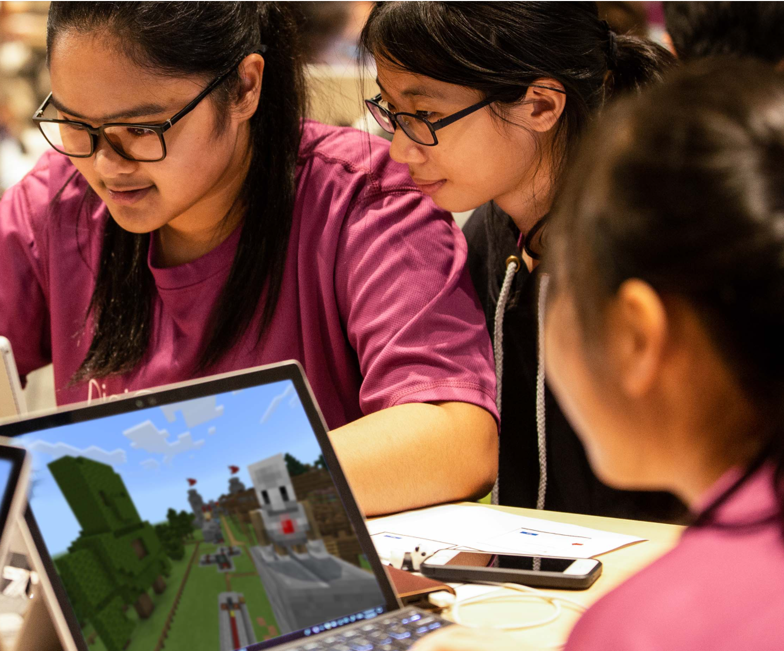
What are some problems that you have experienced when you are online (or even have heard about)?

Slide 8
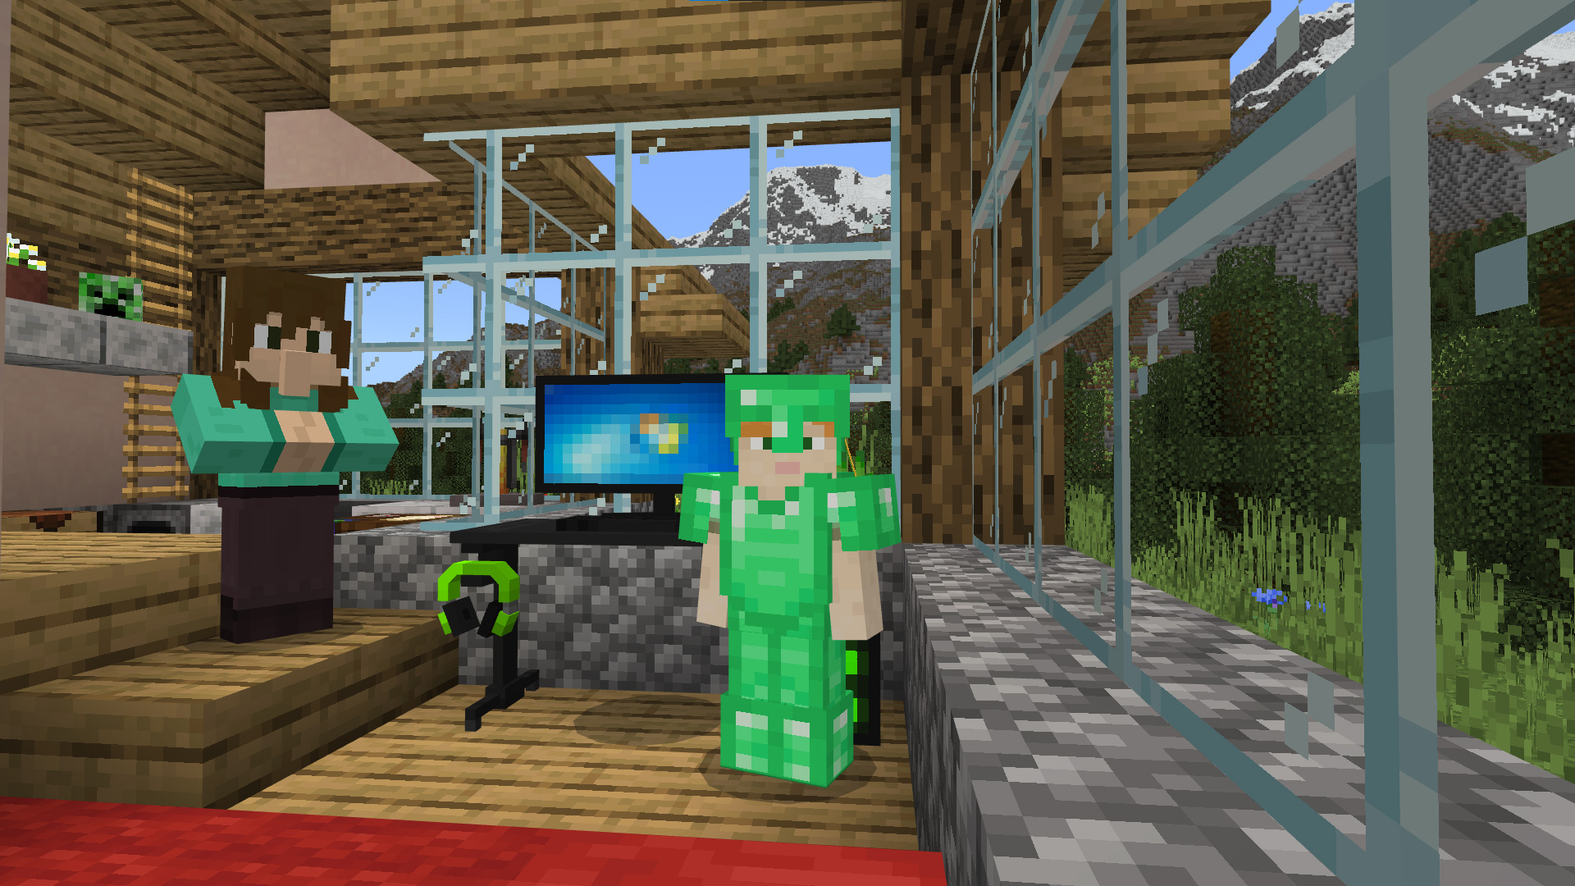
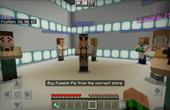
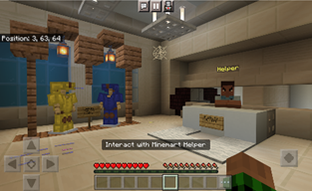
Important Vocabulary
There are some important things for us to understand before we begin playing– let’s review some important examples first!
Safety | Scam | Phishing
These are things that people do to protect themselves or others from harm, loss, or danger. | This is a sneaky or dishonest plan that's meant to trick someone. | This is an attempt to get people to share their personal or financial information.

Slide 9
Goal for the day
As we know, the Internet is a great place. However, it can also be tricky at times.
Our goal for the day is to identify and avoid common cybersecurity risks.
How can we avoid risks?
STOP and THINK… BEFORE YOU CLICK! |  | BEFORE YOU CLICK!
STOP

Slide 10
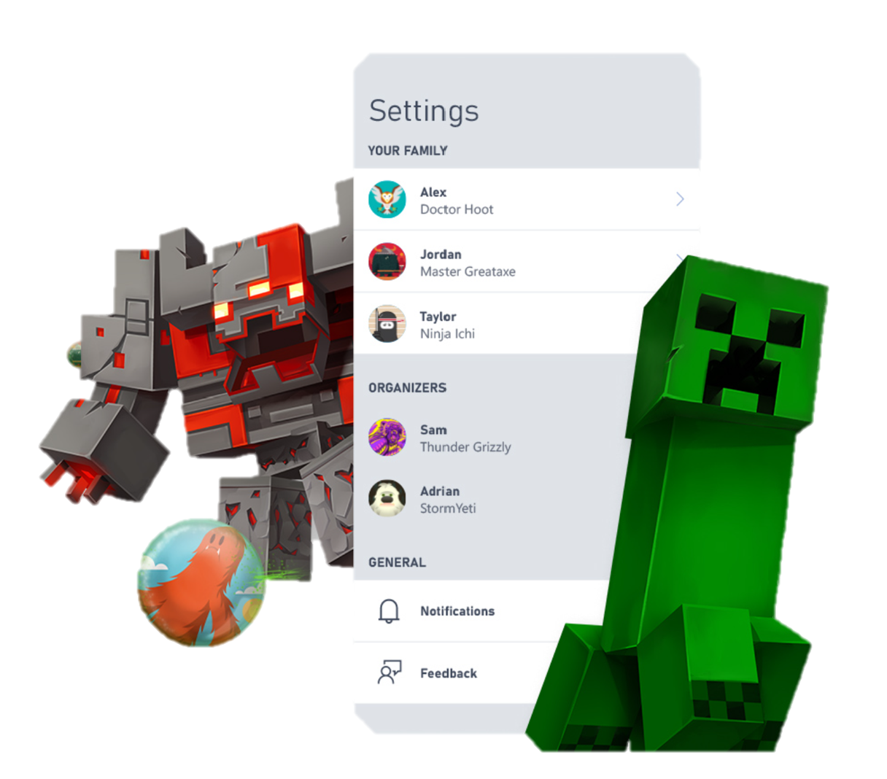
Safer Internet Tips
Here are 5 important safety tips and rules to consider when you are online!

Slide 11
Safer internet tip #1
Respect the settings on the device and/or account.
If your parent or family member has placed settings or controls on your accounts, you need to respect these. Settings and controls are important ways to help keep you safe when you are online.
Some of the settings include:
Screen Time
Privacy (e.g., friend requests, chat features, etc.)
Content Features
Online Purchases

Slide 12
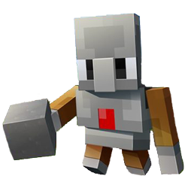
Safer internet Tip #2
2. Protect your personal information.
What exactly is personal information?
What is personal information?
What is public information?
Personal information is any information that directly identifies an individual. This information should be kept private.
Example of Personal Information include:
Full Name
Birthdate
Address
Phone Number
Any Governmental ID Number
Public information is any information that is NOT considered confidential or personal.
Example of Public Information include:
Username
Avatar

Slide 13
Safer internet tip #3
3. Don’t believe everything you hear, read, or see on the Internet.
If it sounds too good to be true, then it most likely is…
When in doubt, you should not:
Click on random links sent to you from unknown sources
Download files from unknown sources
Install any new software, app, etc. from unknown sources
Accept random friend requests from unknown identities
Shop online or make online purchases from unknown sources (or without permission from your parents or family members!)

Slide 14
Safer internet tip #4
4. Limit your screen time.
Safety is NOT just limited to your online presence; it is also about your physical health.
Taking regular breaks from game play will help you stay safe and well.
Rest your eyes and protect you from eye strain.
Make sure to eat and drink to keep your body fueled and nourished.
Take care of your responsibilities such as your homework, chores, etc. It is important to not let gaming take priority over your responsibilities!
Spend time with your friends and family. Although gaming is great, it is still important to interact face-to-face to the important people in our lives.

Slide 15
Safer internet tip #5
5. You can always talk to a trusted adult if you need help.
A trusted adult is any grownup whose actions and words make you feel safe—this could be your parent(s), a teacher, coach, family member, etc.
You should reach out to a trusted adult if you ever need help, feel confused, feel uncomfortable, or are unsure about what to do. A trusted adult will be able to help you navigate a situation.

Slide 16
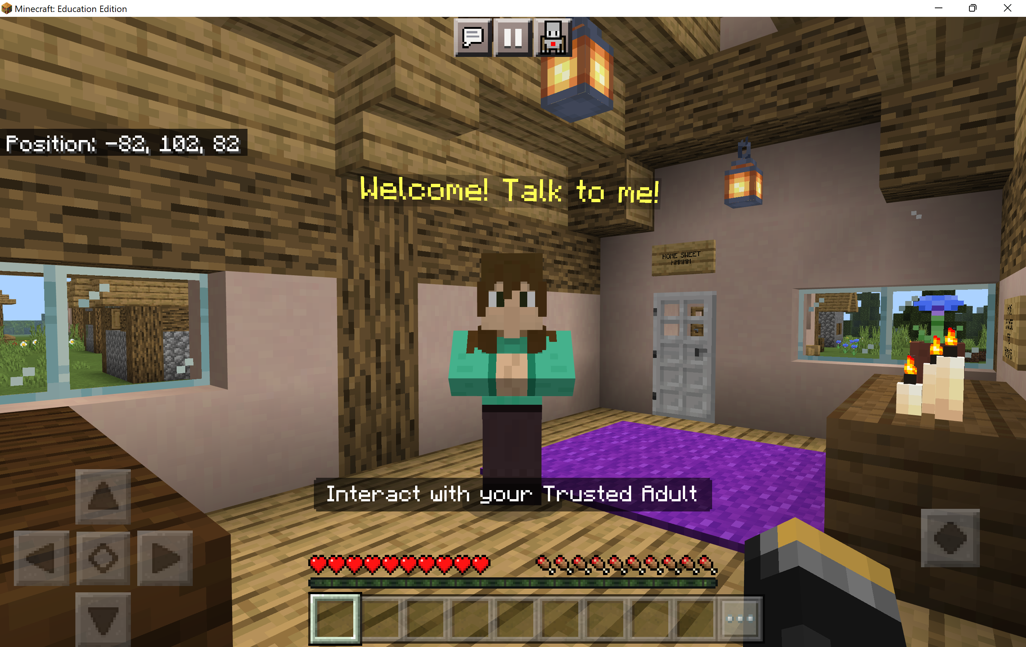
Welcome to CyberSafe
In CyberSafe, you will have 4 activities to complete.
REMEMBER…
{HMM}
Stop and think, before you click!

Slide 17
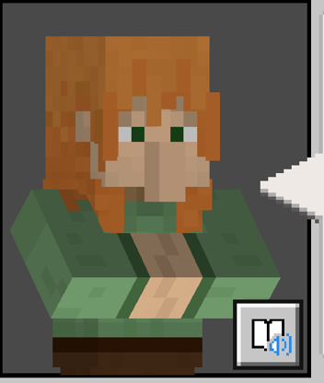
Immersive reader
Immersive Reader can be opened inside Minecraft to read signs and NPC dialogue! It is incredibly helpful!
It’s great for extra help for reading, including translating the text and reading it aloud.
How to use Immersive Reader in Minecraft: Education Edition https://aka.ms/ImmersiveReaderYT

Slide 18
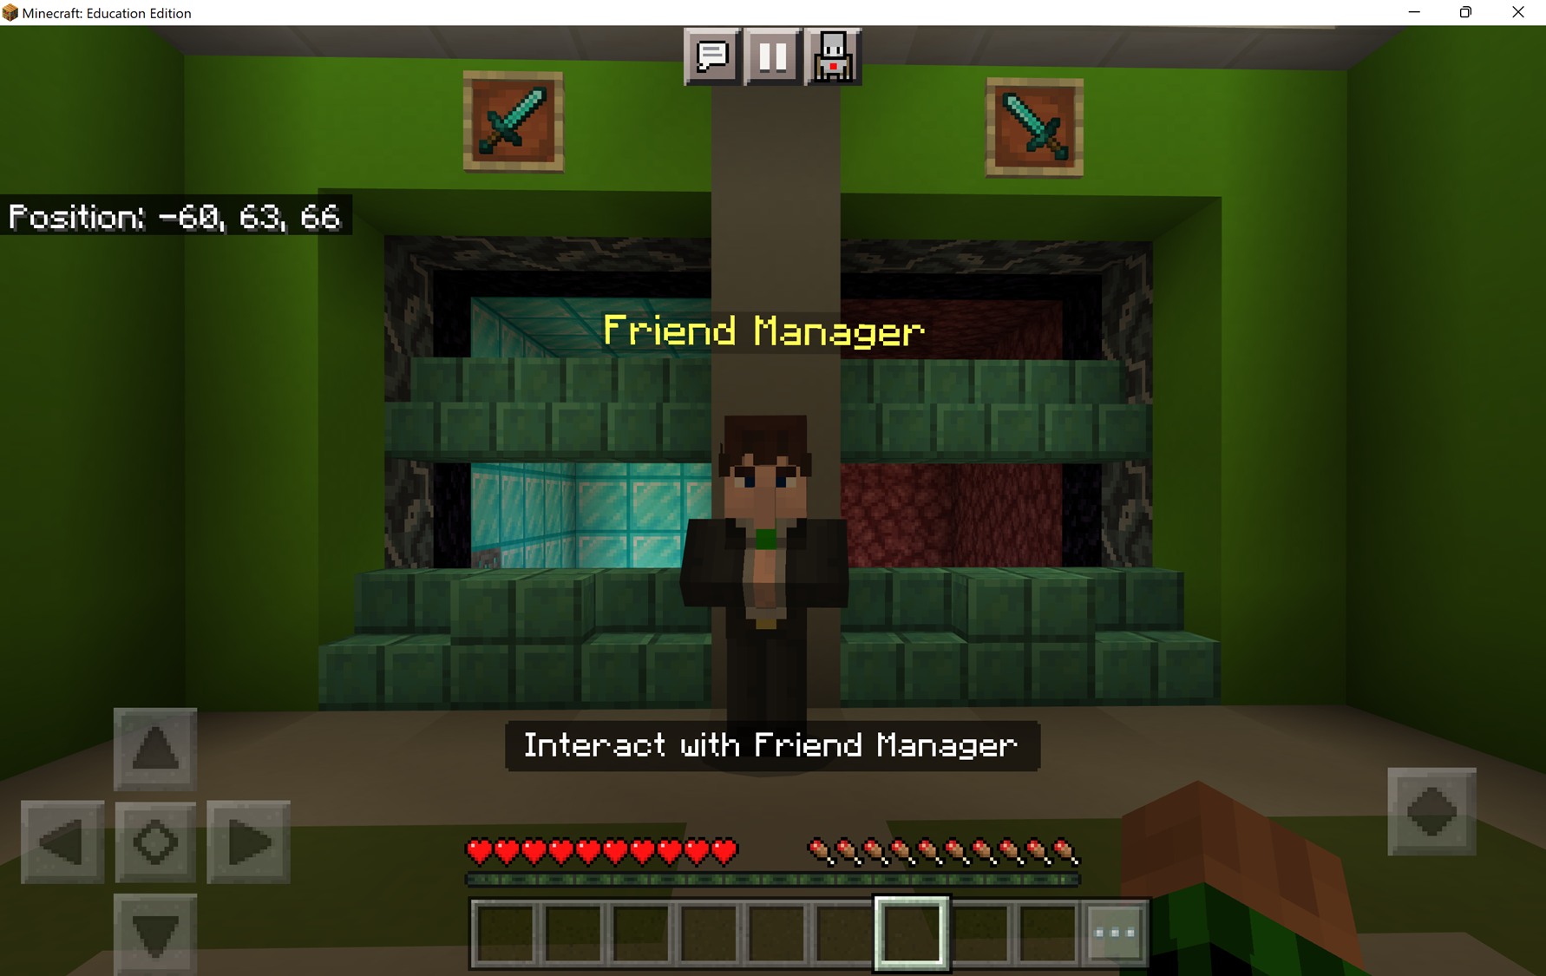
Activity 1
Friend Requests
Your friend, Hayden, wants to play online. When you go online, you have 4 new friend requests. You need to accept the correct friend request in order to try out the rad new parkour!

Slide 19
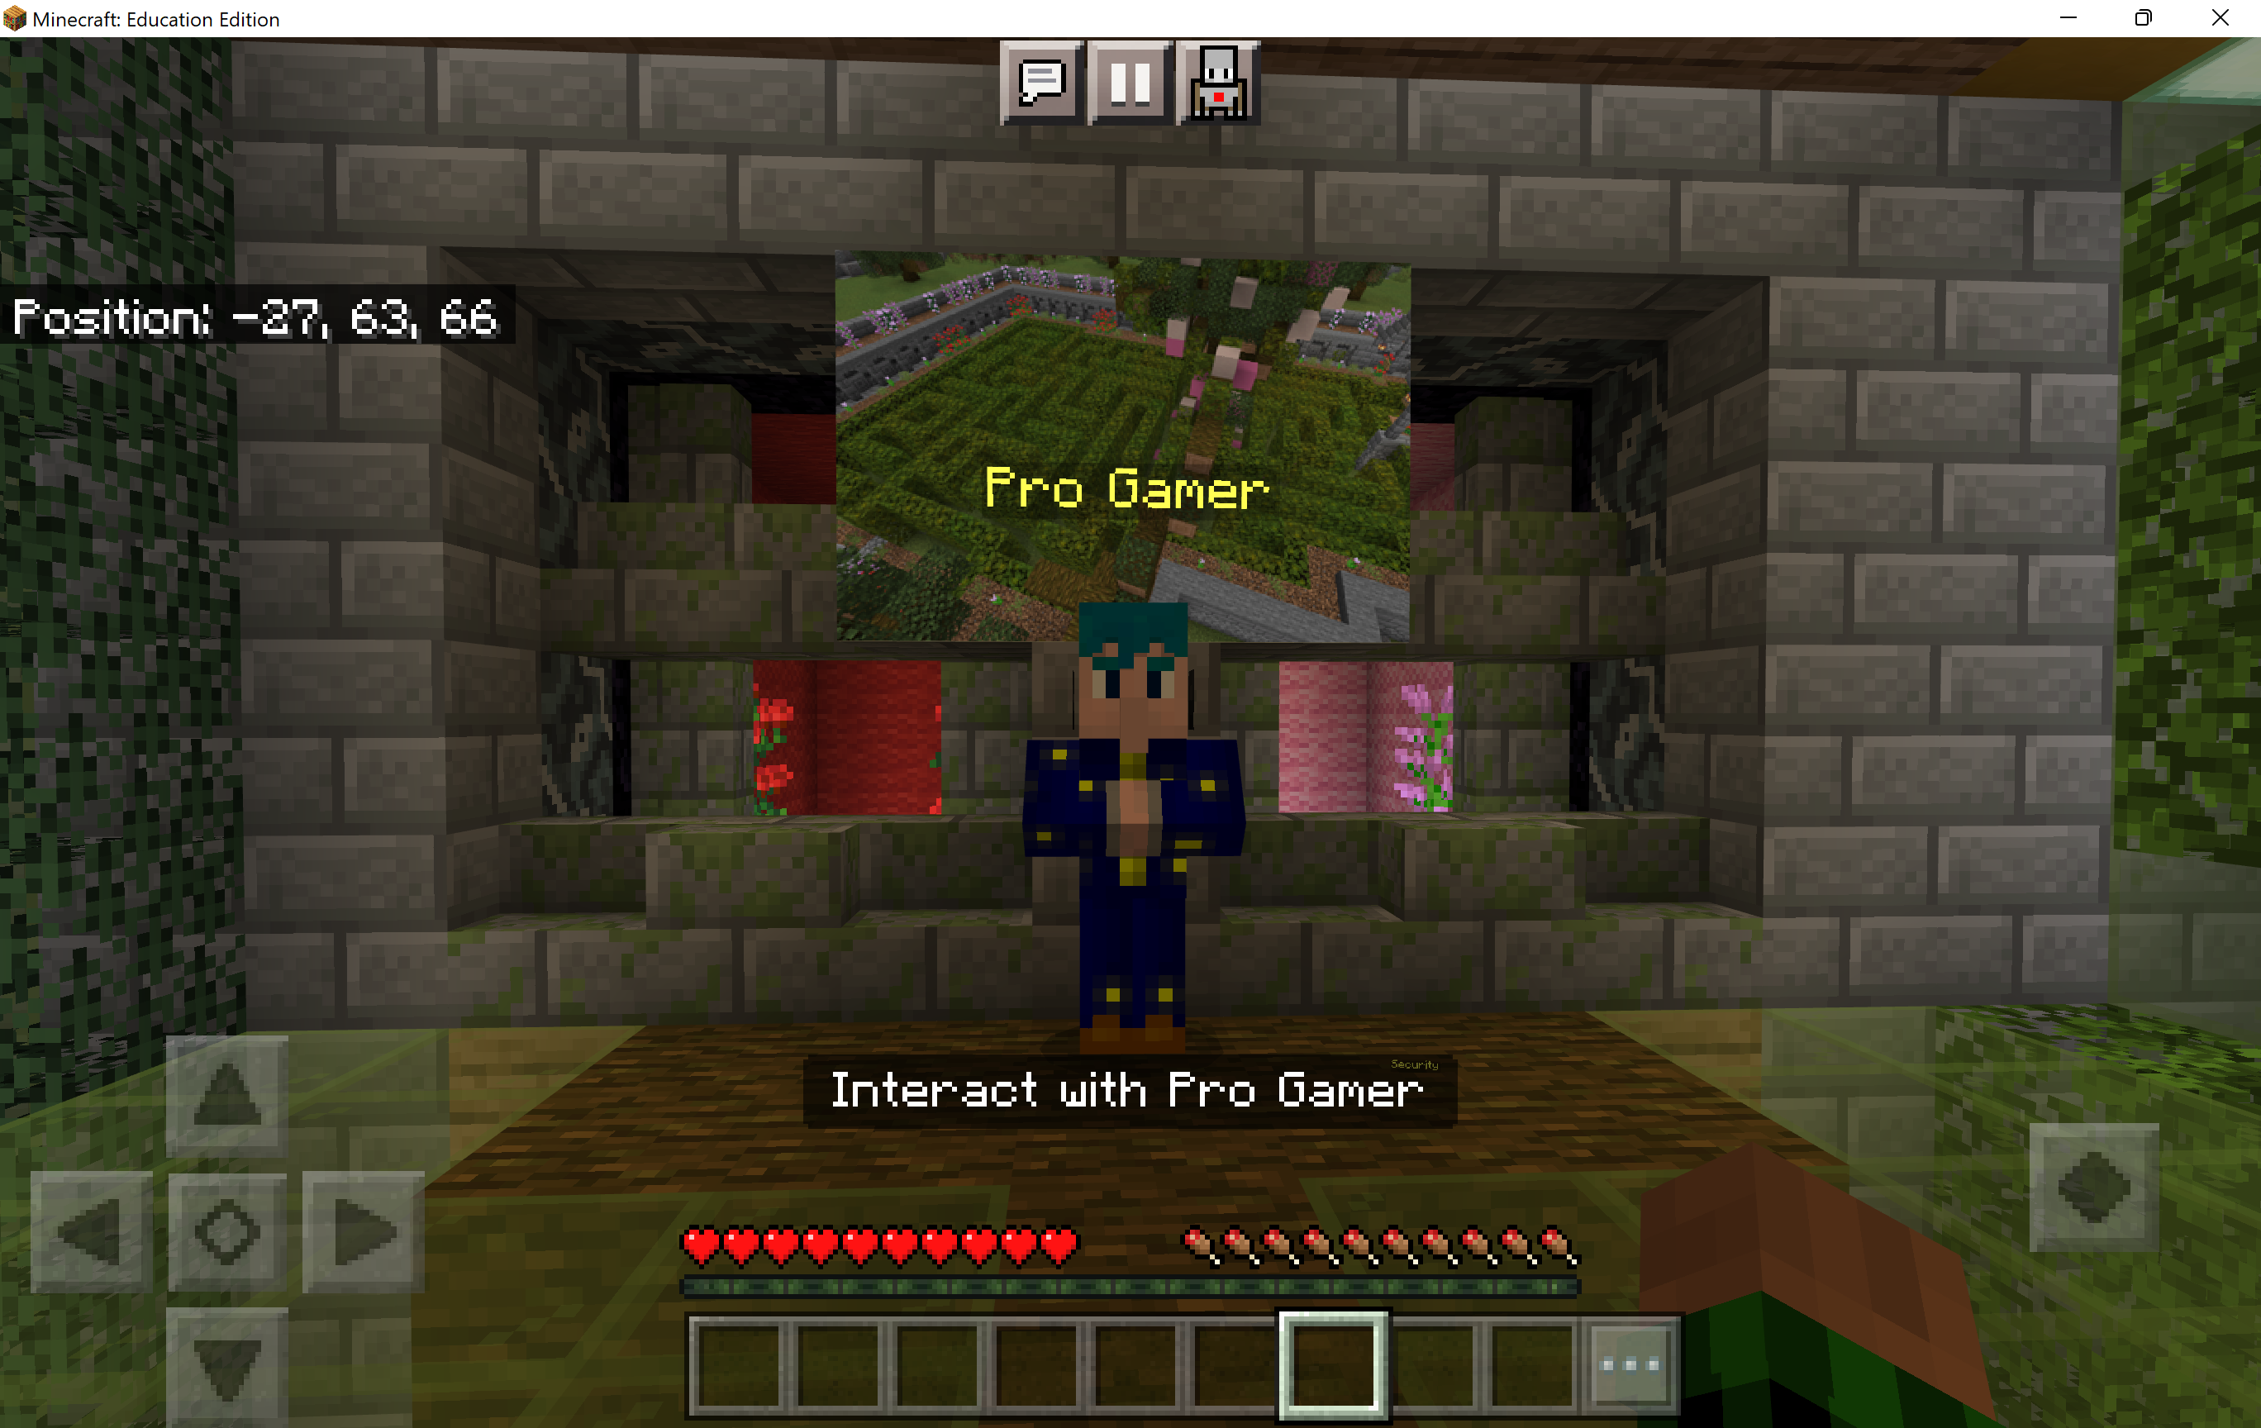
Activity 2
Personal Information
You need to solve this incredibly difficult maze. It’s almost impossible… but ProGamer has a cheat code for you… You just need to share your account password.

Slide 20
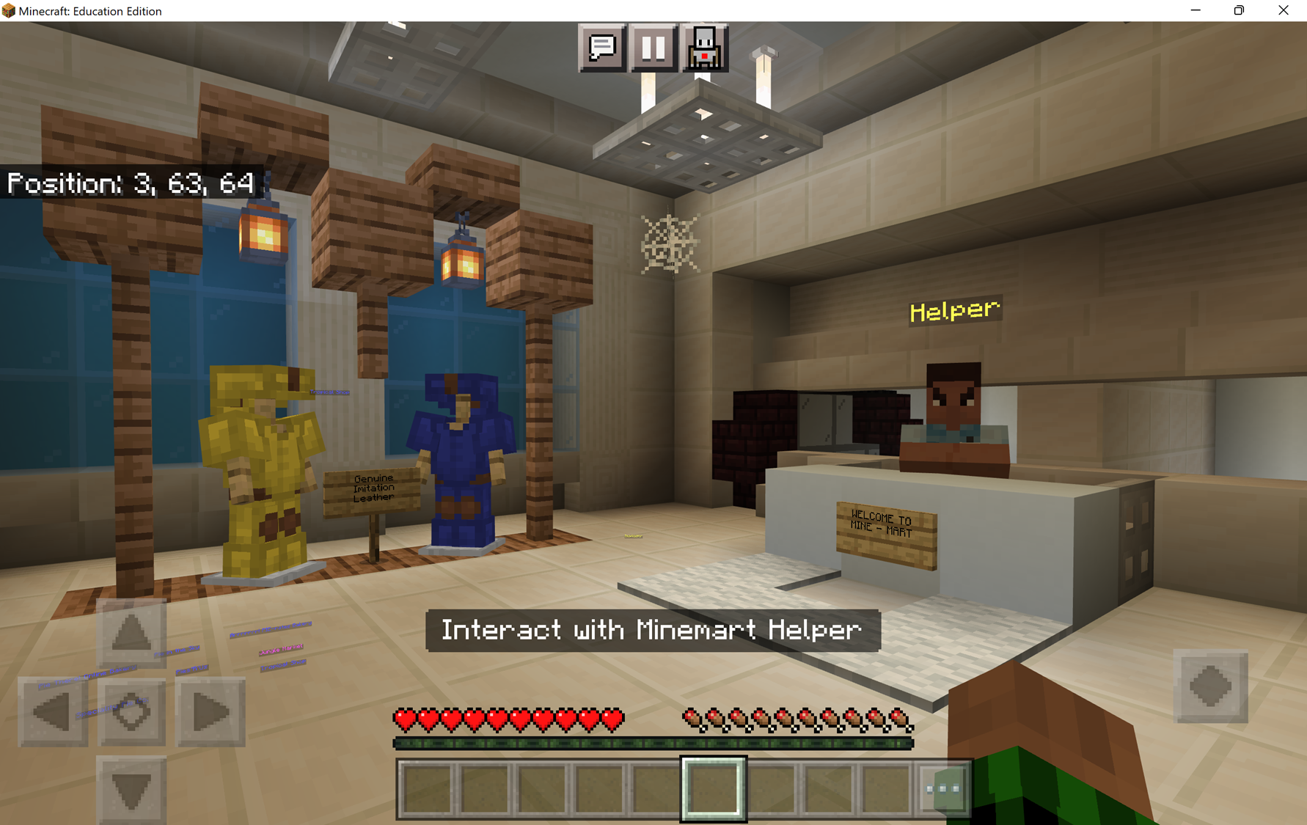
Activity 3
New Armor
Your Trusted Adult bought you this AMAZING new armor, but there seems to be a problem with the order. You have received an email asking for your account information so they can fix the issue.

Slide 21
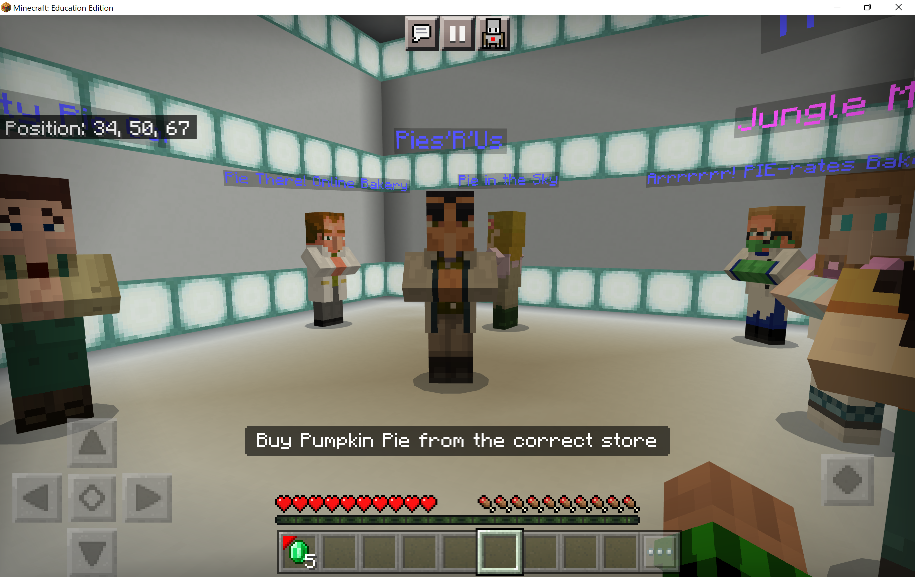
Activity 4
Online Shopping
Pumpkin pies! Your Trusted Adult has asked you to order a pumpkin pie from the Jungle Market. Go online and use the emeralds to buy a pumpkin pies– but wait! There are so many pumpkin pie companies… from whom should you order?!

Slide 22
Recap
What you’ve done today:
Learned about the benefits of the Internet
Learned about common cybersecurity risks while on the Internet
Learned how to stay safe on the Internet by stopping and thinking before clicking on anything
Learned how trusted adults are always available to help
Notes:
Say: We did so much today!
Learned about coding concepts including algorithms, AI, sequencing, debugging, and conditionals.
Programmed your Minecraft Agent to prevent forest fires!
Optional discussion questions:
What role do computers play in preventing forest fires?
What data (information) is important when fighting forest fires?
How can we prevent forest fires from happening?
What is reforestation? And how do you approach it?

Slide 23
Reflection
What was your favorite part of CyberSafe?
Name one positive thing about the Internet.
Name one risk that can happen on the Internet.
How can you stay safe on the Internet?
Why is it important to protect your personal information?
How does a safer internet make a better internet for us all?

Slide 24
Extend your learning
Create a build of cyber safe home in Minecraft
Check out these additional Cybersecurity activities from code.org aka.ms/cybersafecodedotorgresources
Write a song or poem to remind yourself and others to HMMM… Stop and think, before you click!
Collaborate with your peers to create a “Top 5 Safety Online” tips poster
Participate in the Minecraft Build Challenge: Minecraft Instruction Book; create an instruction book on how to report another player if they violate the community standards

