Slide 1
Digital Explorers
Let’s begin

Slide 2
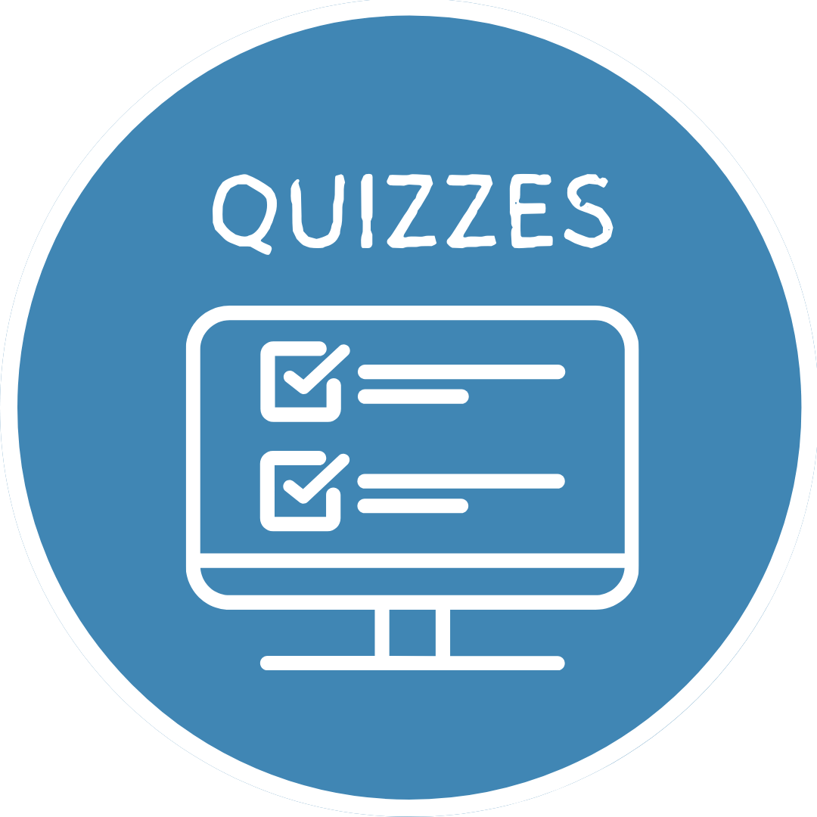
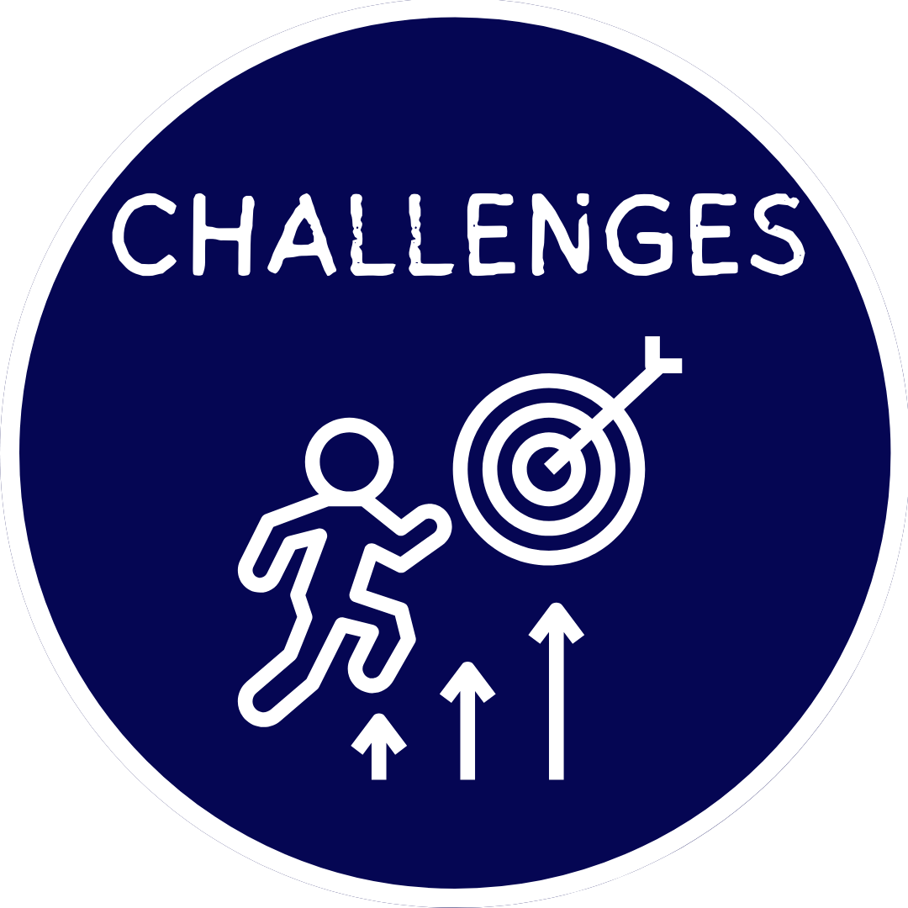
Learn how to Become a digitally Literate Scholar
Click on the Image below to select one of the interactive activities :

Slide 3
Tutorials
Online Searching
Cyber-Bullying
Digital Content
Creator

Slide 4
Quizzes
Safe Online Searches
Cyber-Bullying
Digital Content
Creator

Slide 5
Scenarios
Safe Online Searches
Cyber-Bullying
Digital Content
Creator

Slide 6
Safe
Online Searching
Cool interactive lesson would take place here.
Notes:
Reliable and Safe Online Searching

Slide 7
Cyber-Bullying
Cool interactive lesson would take place here.

Slide 8
Digital Content
Creator
Cool interactive lesson would take place here.

