Slide 1
Artificial Intelligence
Kara Dawson
Information Technology Support Teacher
SD#71 (Comox Valley)
Microsoft Innovative Educator Expert
kara.dawson@sd71.bc.ca
(250) 338-1425

Slide 2
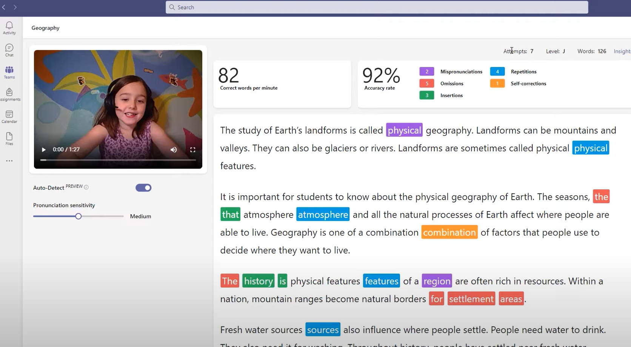
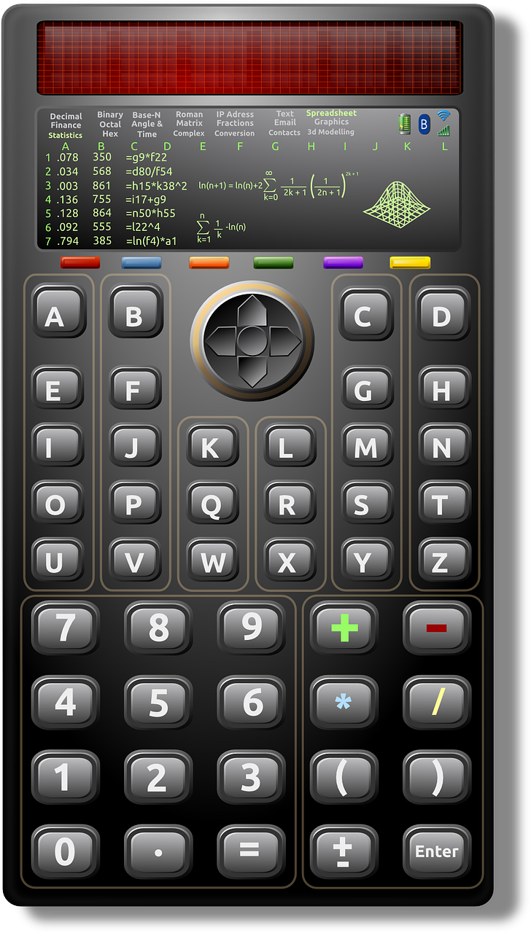
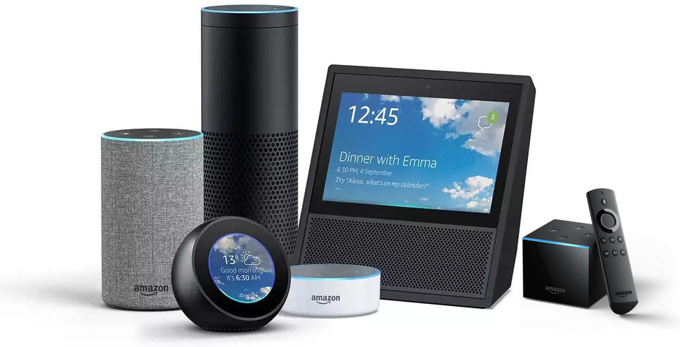
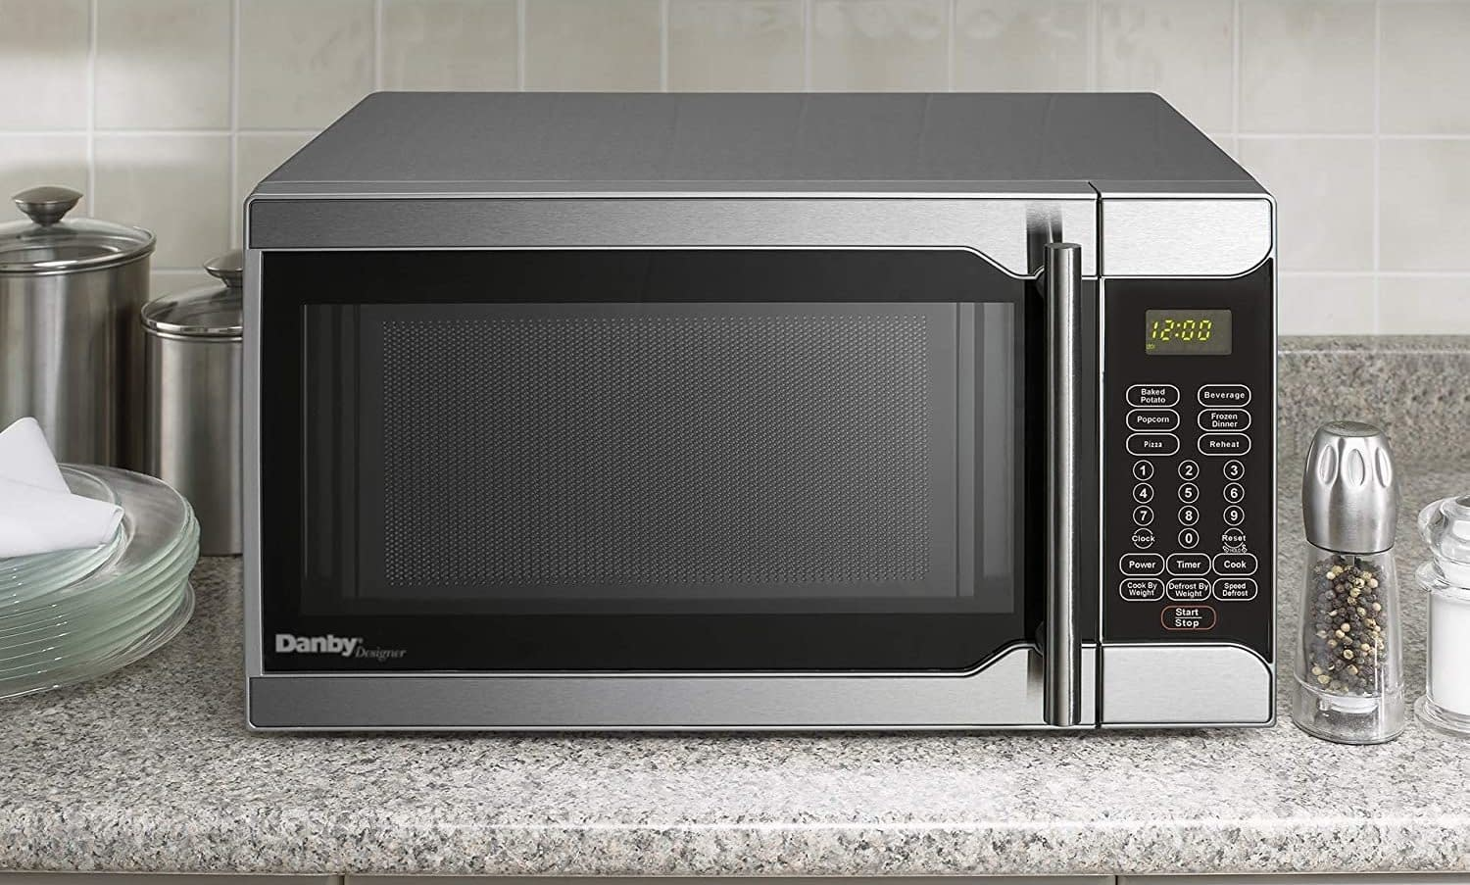
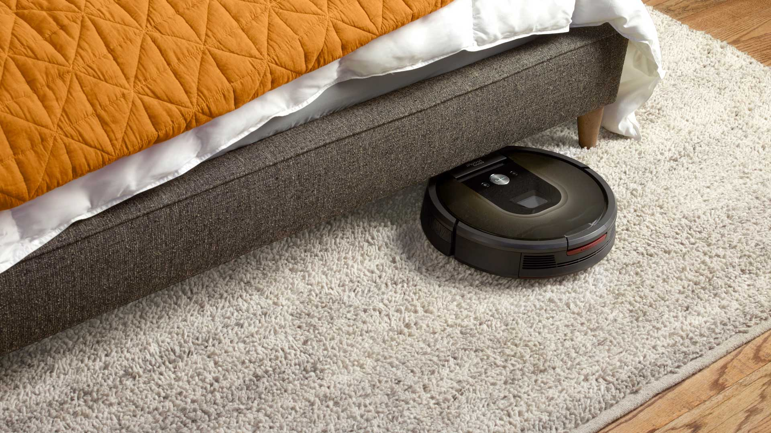
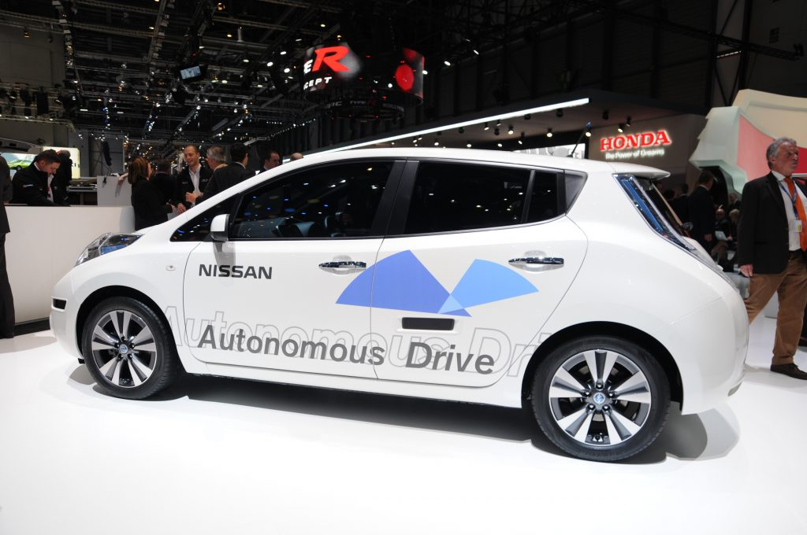
Artificial Intelligence or not?

Slide 3
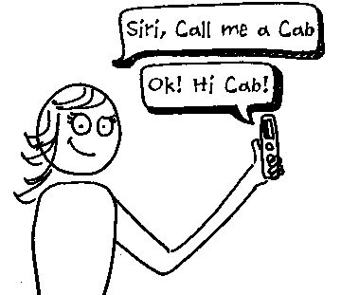
What is Artificial Intelligence?
How is it related to Machine Learning?

Slide 5
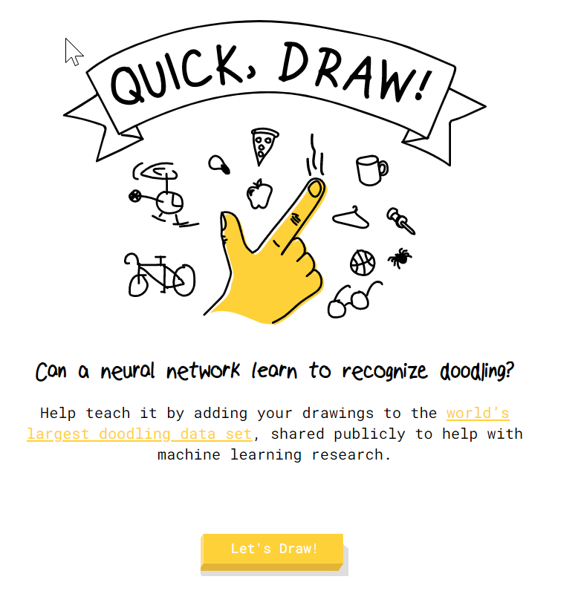
Now Let’s Try…
quickdraw.withgoogle.com

Slide 6
Machine Learning for Kids
By IBM
https://machinelearningforkids.co.uk/

Slide 7
Follow up questions:
Now that you have actually trained a machine what did you learn? What did you think about it?
How could machine learning lead to bias in AI?
If AI is trained this way, what problems could this lead to if you are using AI?

