Slide 1
Numeracy for Next Year
Pen-to-Paper Planning with reflections & curiosities
May 29, 2024
Serina Allison

Slide 2
We respectfully acknowledge that we are meeting today on the traditional, unceded territory of the Pentlatch, Ieeksun and K’omoks people who have been stewards of this land since time immemorial. We thank them for the privilege of working with their children.

Slide 3
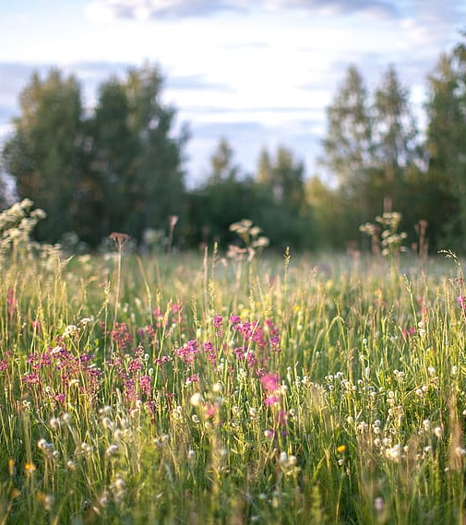
Welcome!
Reflect
Framework connections
Routines and structures
Assessment
“Filling it in”
Reflection
Notes:
3:30

Slide 4
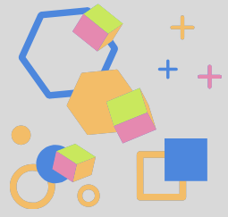
“The most productive tool for generating good ideas remains a circle of humans at a table, talking shop.” Steven Johnson, Where Good Ideas Come From

Slide 5
1. Reflection
Sticky note favourites!

Slide 6
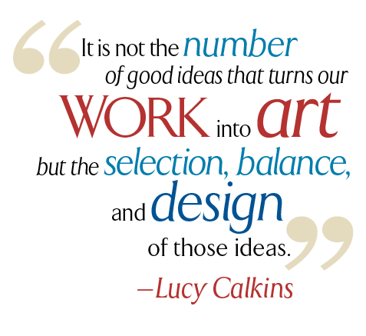
What are your favourite routines and weekly activities?
Where are they in your week?
What about them makes them so valuable?
Are they non-negotiables?

Slide 7
What are your favourites?
“Anticipation creates intention….”
Activities
Projects
Rich Tasks
When do you do them?
How do they fit into your week?
Your year?
How do you plan for success?

Slide 8
What was New?
Was there a new idea or routine you tried this year?
How did it go?
Do you want to keep it?
What might you change?

Slide 9
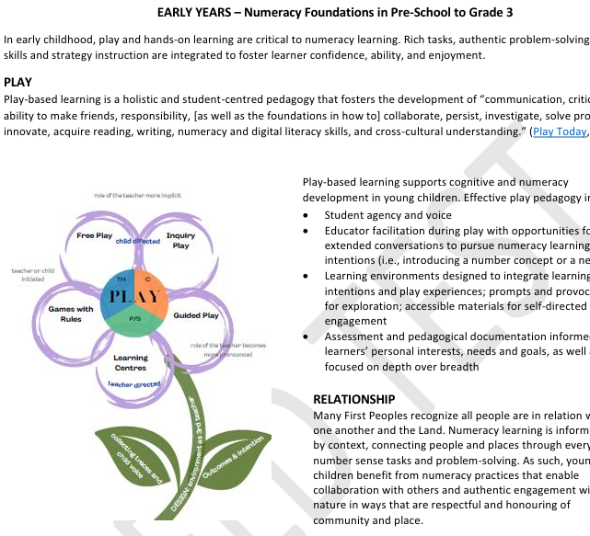
2. Framework connections
What are the main themes?
Where do you see your own practice in here already?

Slide 10
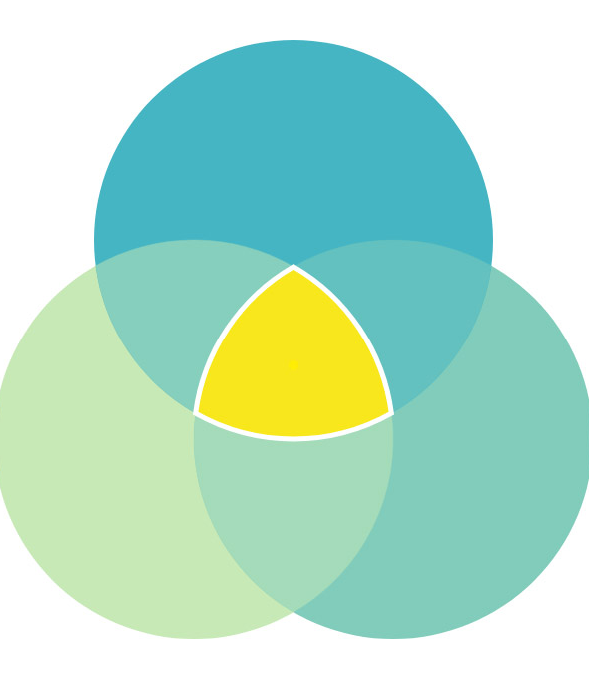
The framework as a mirror and a window…
Using the large paper, create a Venn diagram of the three main pillars of the Framework:
Play/Experiential learning
Relationship/Community
Numeracy Foundations

Slide 11
3. Routines and Structures
“Harvesting the wisdom in the room”

Slide 12
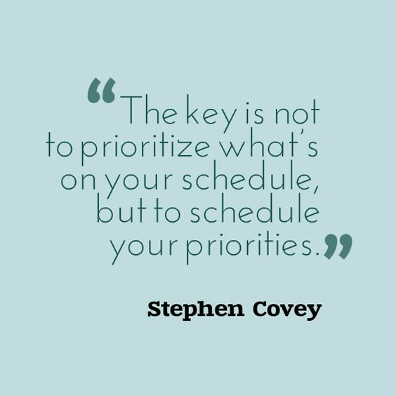
1 hour of Numeracy a day
Where else do we see numeracy throughout the day?
New and foundational concepts for the grade are introduced in the first part of the school year. Revisiting multiple times throughout the year.
Continue development of number sense and computational fluency over the entire year.
During “reporting periods” have a balance of number focused content and other areas of math learning so students can show their strengths through different concepts.

Slide 13
Before I can teach a routine, I need a structure to teach it within
Structure
skeleton
not flexible, “part of the furniture” of the day
provides boundaries and constraints
Routine
pattern
repeated,
predictable,
but flexible content

Slide 14
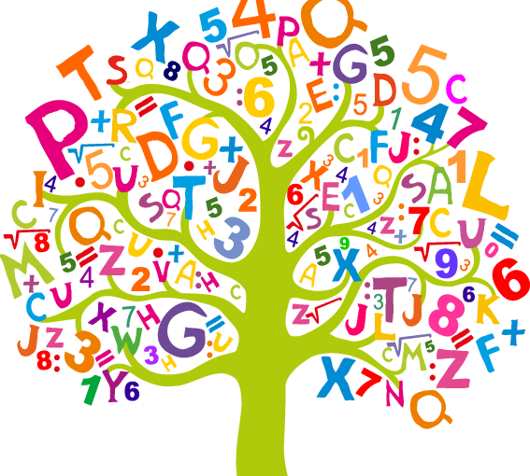
Routines provide feelings of belonging, ownership, and predictability, which make the classroom a place to take risks, try new things, and be successful.
~ Jessica F. Shumway

Slide 15
Examples
Structures
Morning meeting
Book Time
Daily 3
Math Workshop/Numeracy Centres
Planners
Morning message
Settle in
Snack/Lunch
Routines
Number Talks
Image talks/dot talks
Choral Counting
Clothesline/Number Line
Vertical non-permanent surfaces
Problem Solving
Reflection
Manipulatives
White boards
Numeracy Games/Puzzels
3 act task
What are some other structures and routines?
What do you do?
What sparks your interest to learn more about?

Slide 16
Backwards Design
What do we want students to leave the year with? What story will they leave with? How will they feel about math?
What assessments will we use? How will I set up for success?
What routines can we build over time?
What structures and routines do we need to start in September? Start as you mean to go.
What opportunities might students have to apply mathematics to other areas of learning or contexts? (Outdoor learning, cross curricular, PE, School garden, Seasonal Rounds, Events)
What materials will support student thinking? (Manipulatives, Number lines, white-bords, carpet)

Slide 17
Jo Boalers Week of Inspirational Math
First 20 Days of Math- Simcoe County, ON

Slide 18
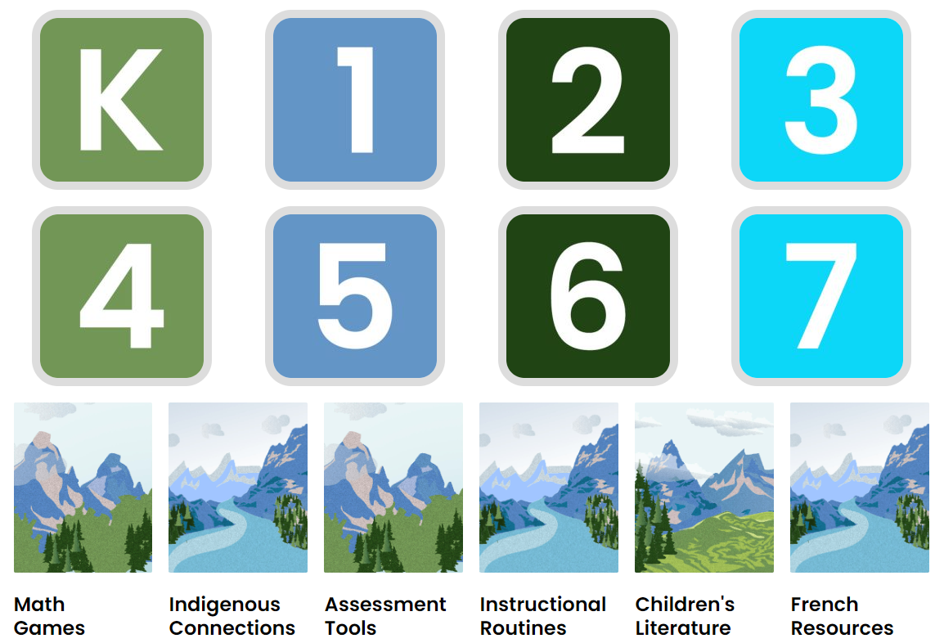

Slide 20
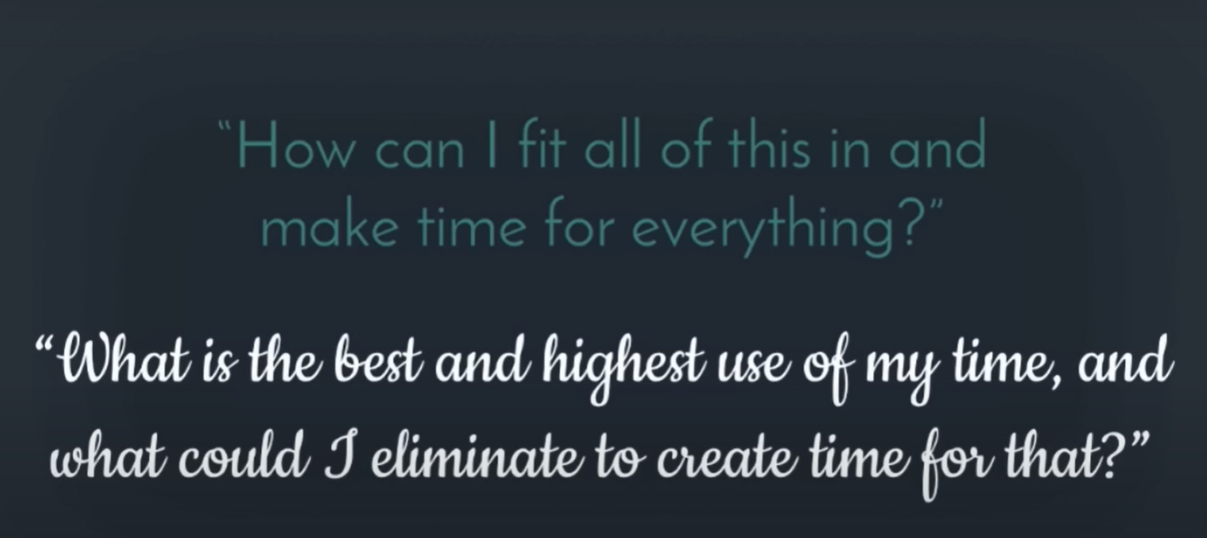
Consider numeracy across subjects….

Slide 21
5. Assessments
Formal
Summative
Formative
Informal
Work samples
Conversation
Observations
Student voice
Core competencies
Conferring 1-1
Formal conferences

Slide 22
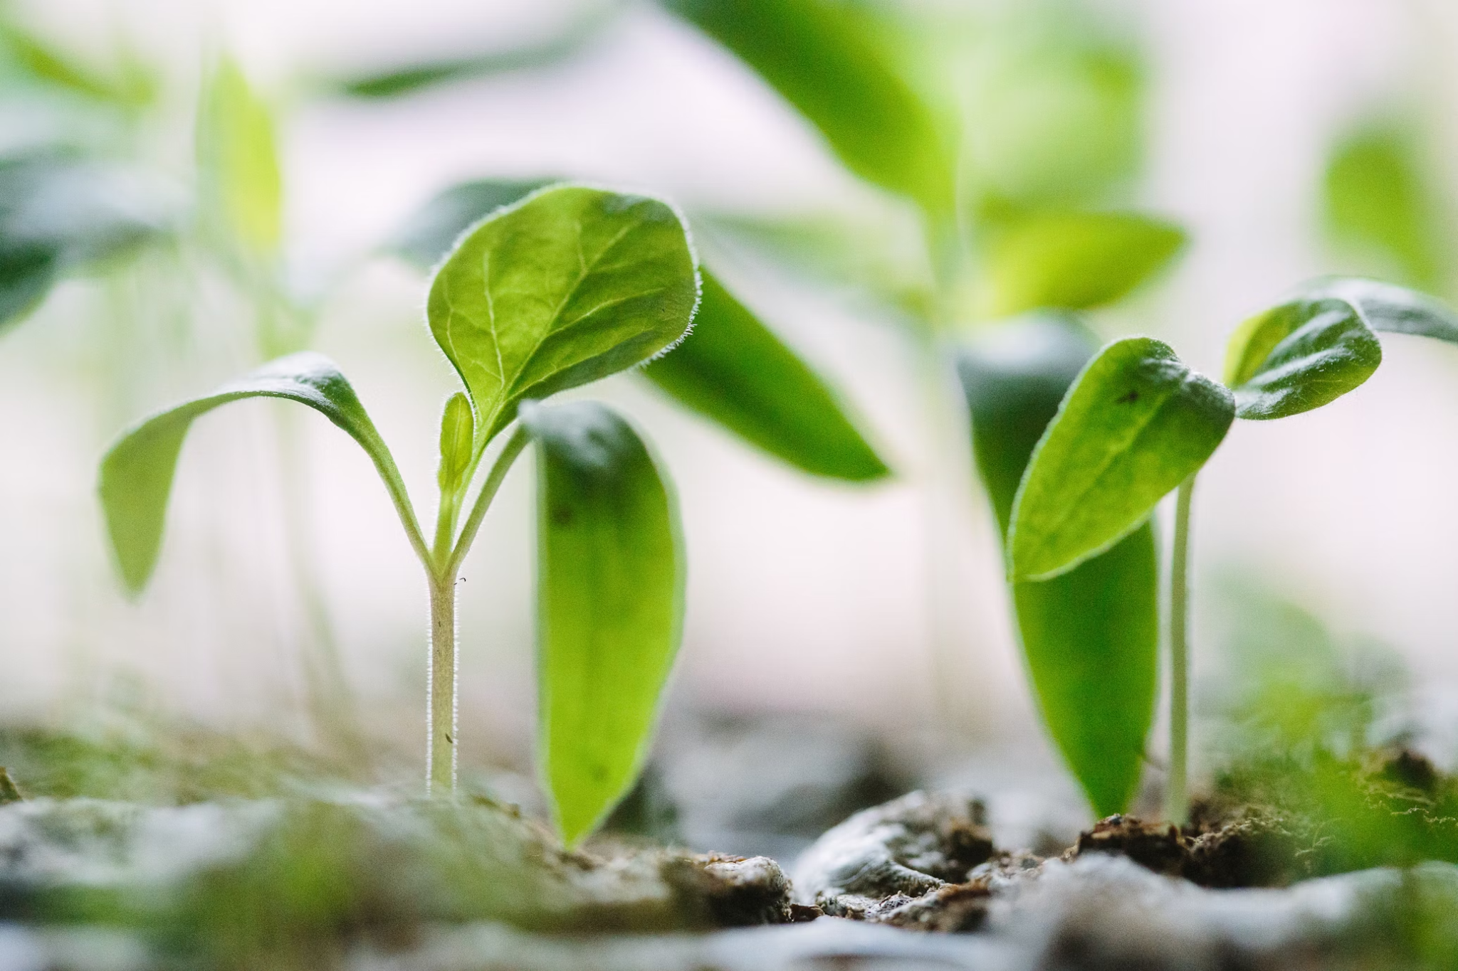
We value what we measure.
Do we measure what we value?

Slide 23
4. “Filling it in”
Start as you mean to go …..
and Backwards Design

Slide 24
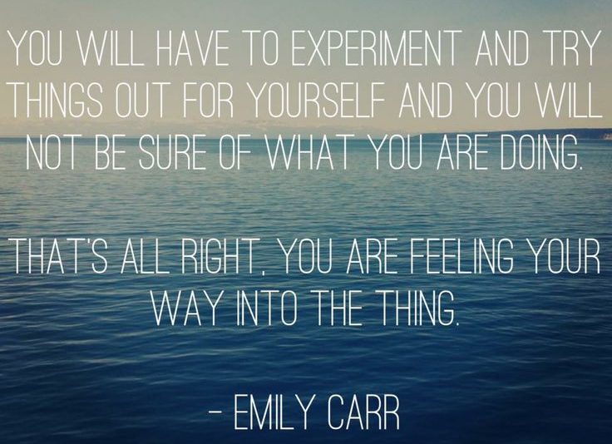

Slide 25
6. Reflection
Did you notice any gaps?
What learning might you need to do?
What excites you about next year?

