Slide 1






Monday Math Moments
M³
Instructional routines and resources to support
flexible thinking and fluency in mathematics
&
build strong mathematical communities

Slide 2

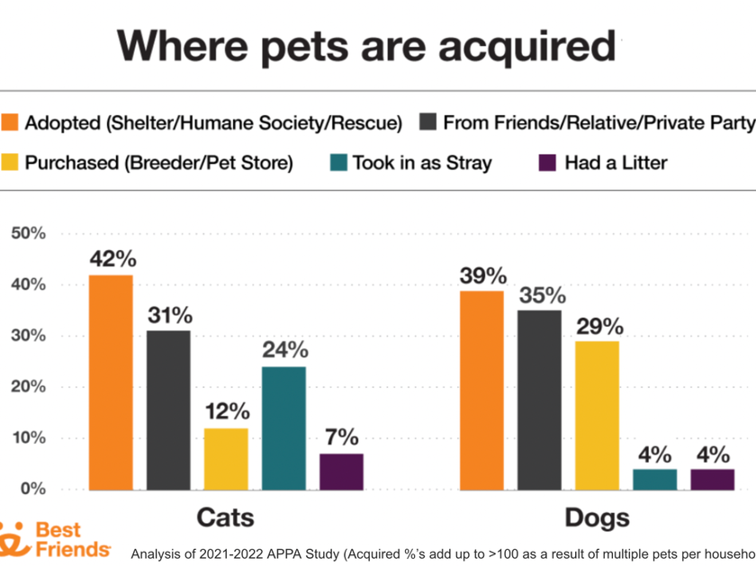
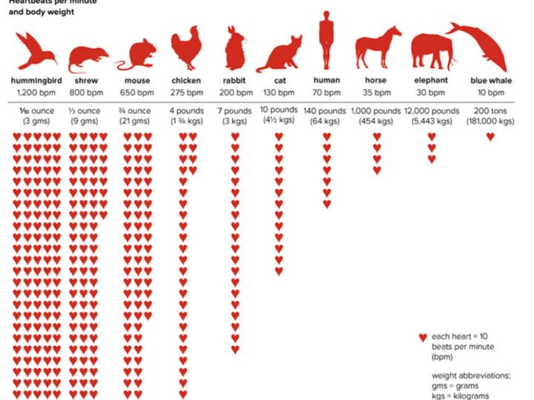
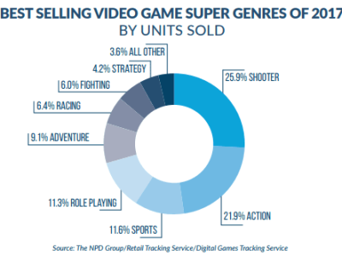
A routine that promotes sensemaking about data.
This routine uses scaffolded visuals and discourse to help students make sense of data. As more of the graph is revealed, students refine their thinking and construct meaning.
Slow Reveal Graphs

Slide 3
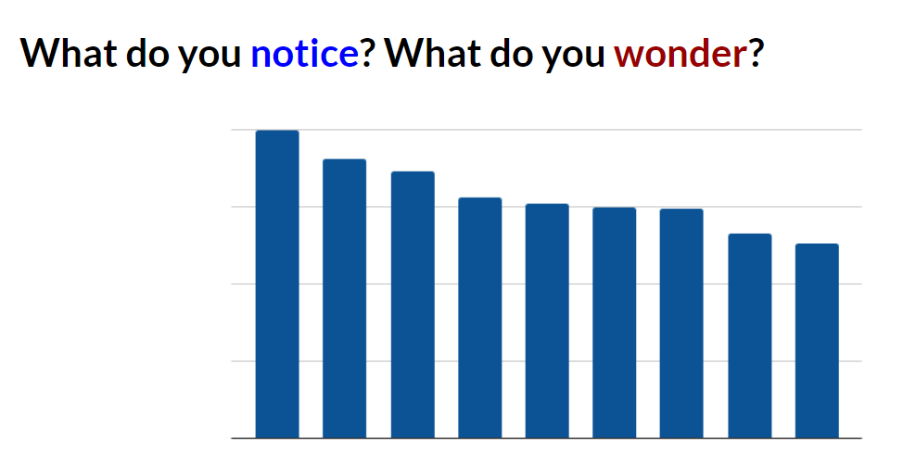
What could this graph be about?
How does this new information change your thinking?

Slide 4
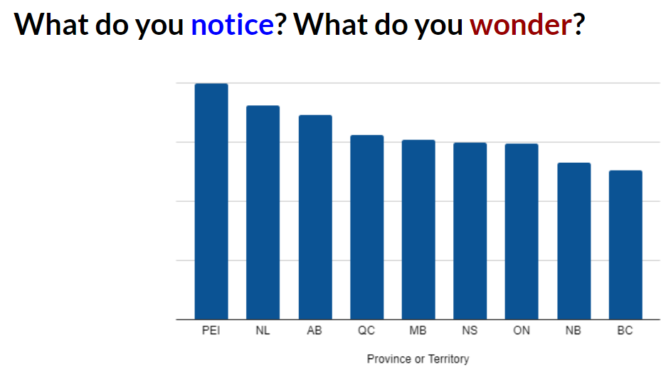
What could this graph be about?
How does this new information change your thinking?

Slide 5
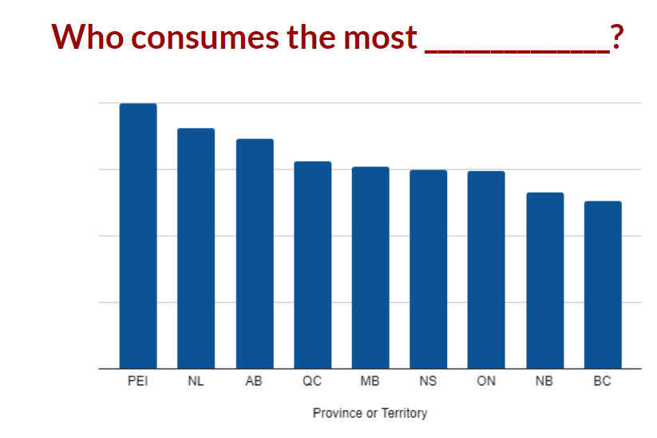
How does this new information change your thinking?

Slide 6
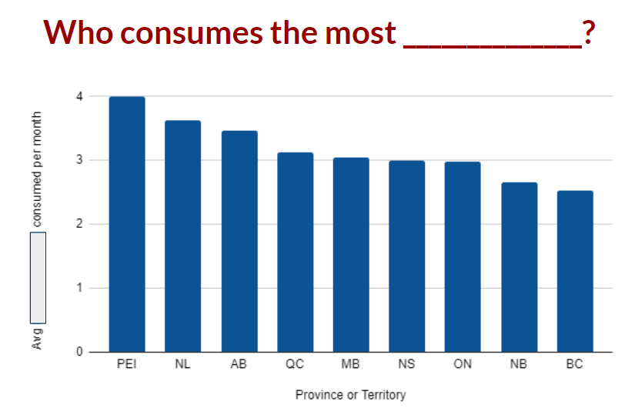

Slide 7
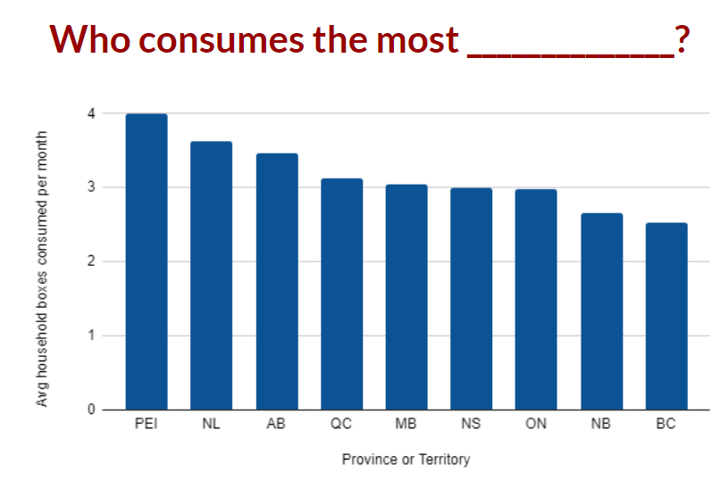
How does this new information change your thinking?

Slide 8
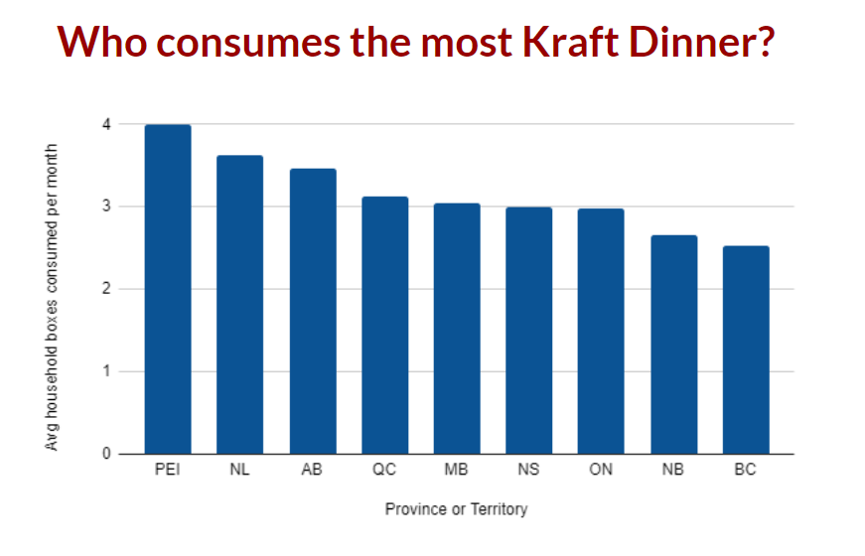
What wonderings do you still have?

Slide 9
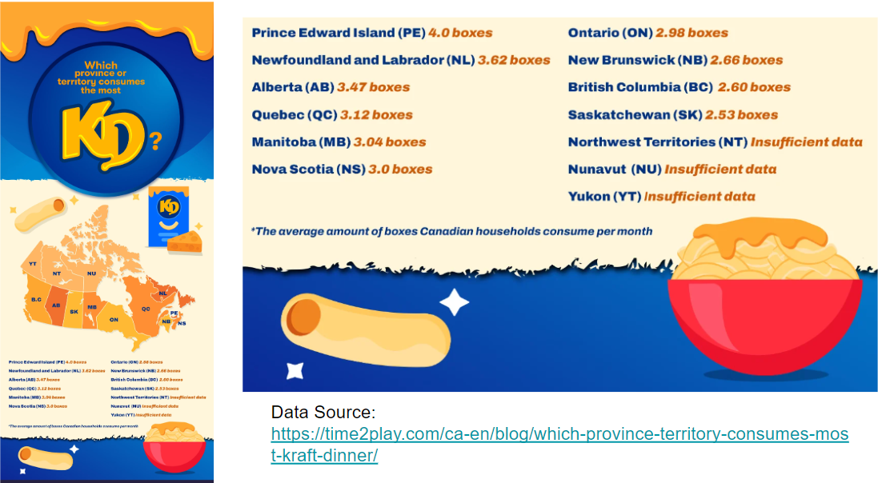

Slide 10
Slowrevealgraphs.com

Slide 11
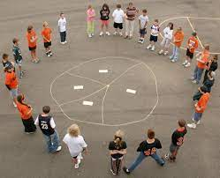
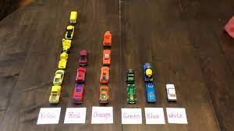
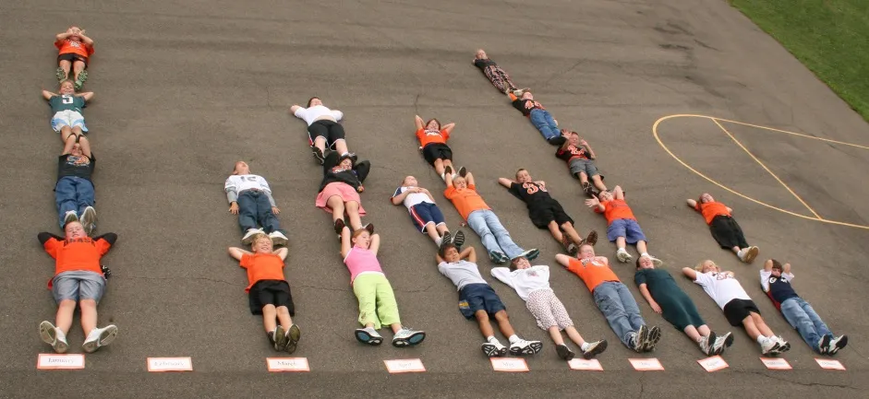
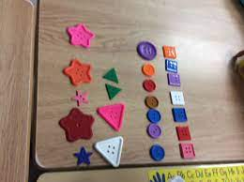
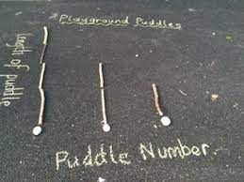
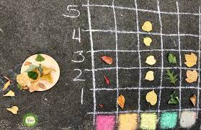
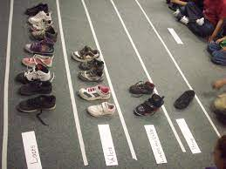
Concrete Examples

Slide 12


How are we viewing Math and Numeracy in other subject areas?

Slide 13
Monday Math Moments
M³
serina.allison@sd71.bc.ca

