Slide 1
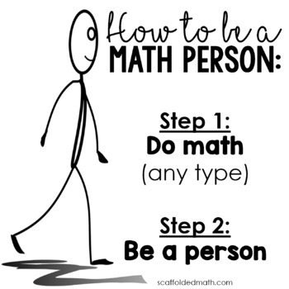
Building Computational Fluency through Number Talks
Alex Sabell and Serina Allison

Slide 2
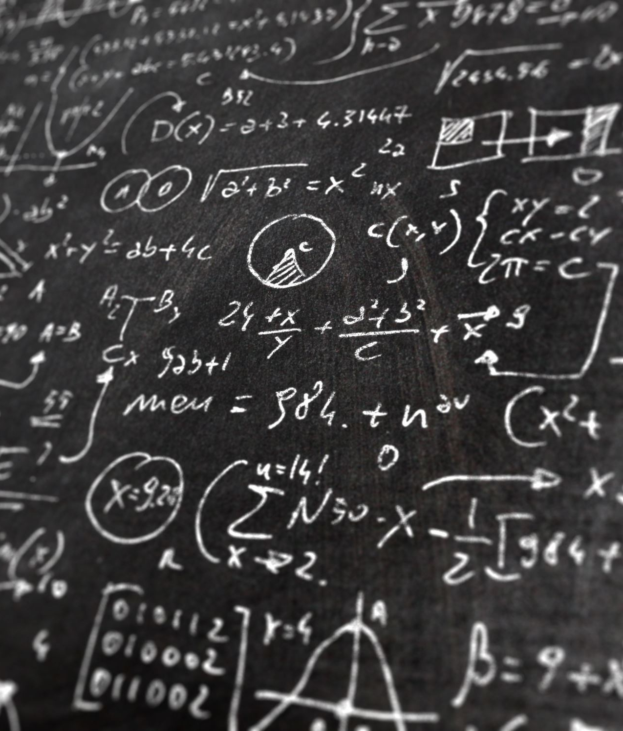
What is Computational Fluency?
National Council for Teachers of Mathematics (NCTM) states “Computational fluency refers to having efficient and accurate methods for computing. Students exhibit computational fluency when they demonstrate flexibility in the methods they choose, understand and can explain these methods, and produce accurate answers efficiently.”

Slide 3
Our Curriculum
Grade 1- Addition and subtractions with numbers to 10 can be modelled concretely, pictorially and symbolically to develop computational fluency.
Grade 3- Development of computational fluency in addition, subtraction, multiplication, and division of whole numbers requires flexible decomposing and composing.
Grade 5- Computation fluency and flexibility with numbers extend to operations with larger (multi-digit numbers).
Grade 8- Computational fluency and flexibility extend to operations with fractions
Grade 11- Logical reasoning helps us discover and describe mathematical truths. Apply flexible and strategic approaches to solve problems
Grade 12- Develop thinking strategies to solve puzzles. Think creatively and with curiosity and wonder when exploring problems

Slide 4
Building Computational Fluency versus Memorization
Computational Fluency is about… | Memorization for recall is about…
Thinking, Accuracy, Efficiency and Flexibility (although the emphasis is not on speed, recall improves and there is meaning behind the facts) | Recall from memory Speed
Building number sense and understanding- making sense of numbers and relationships (ex. numbers are composed of smaller numbers, numbers can be broken apart and combined with other numbers to make new numbers) | Memorizing steps and a procedure Does not lead to number sense
Addressing curricular competencies, for example, reasoning and logic, communication, defending and justifying etc. | No competencies addressed
Learning strategies and concepts that connect to other mathematics | You only know what you have memorized

Slide 5
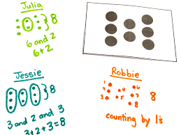
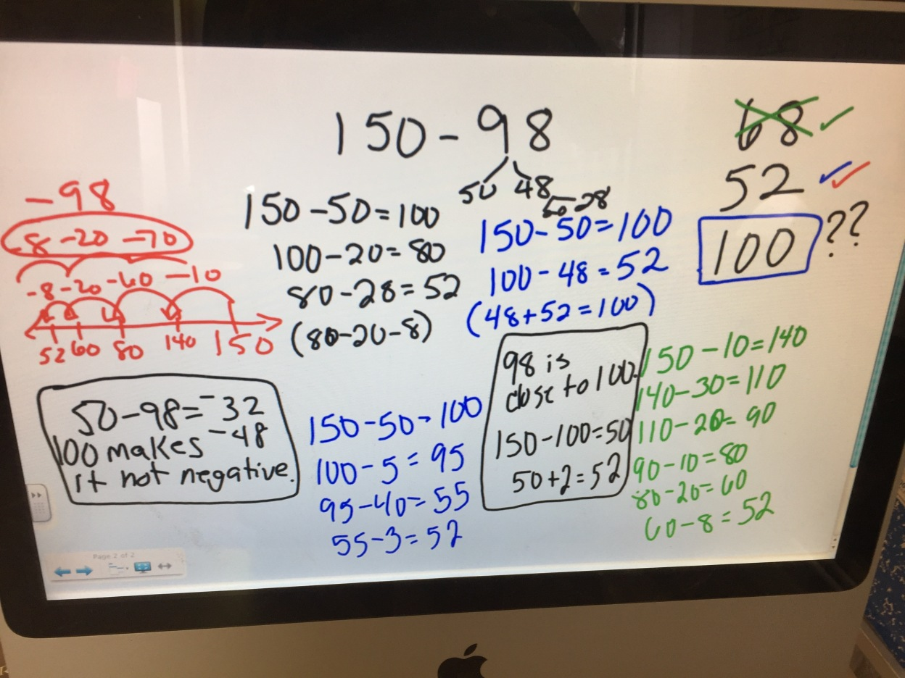
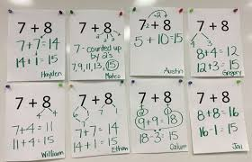
What is a Number Talk?
A Number Talk is a 10-15 minute routine where students mentally solve computation problems and discuss their strategies. Through this meaningful routine, students are developing number sense, developing mental math skills, and engaging in creative, open mathematics.
Notes:
1.) question or image
2.) thinking time
3.) solutions
4.) Sharing or strategies while teacher helps name, insert language, visual, modeling showing their thinking (

Slide 6
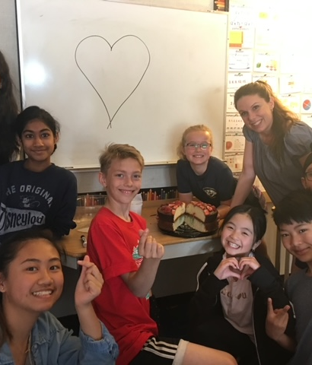
Creating a Community of Math Learners
Number talks provides an opportunity to create an environment within the math context, where a shared set of positive values and norms are established. Where students feels safe to share their ideas, where mistakes are seen as an opportunity to learn together. Where everyone sees themselves as a mathematical thinker with something valuable to say.

Slide 7
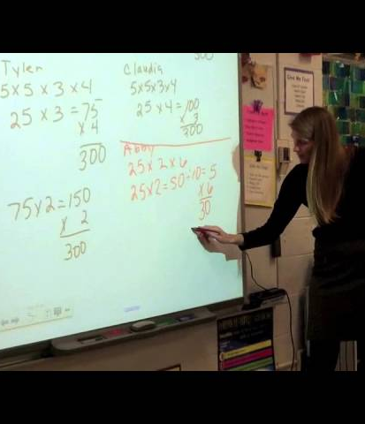
Teacher Moves
Emphasizing strategy over answer
Thumbs instead of hands, counting off strategies
Visually representing
Brought closer for engagement
Inserting language and labeling
Writing strategies on board
Don't have to do everything- do what you can. Learn a long side

Slide 8
Dot Card Kindergarten Number Talk
As you watch the number talk consider...
1.) What teacher moves are present?
2.)What question prompts to do you notice?
3.) What mathematical concepts or ideas are being built upon during the number talk?

Slide 10
Primary Number Talk
As you watch the number talk consider...
1.) What teacher moves are present?
2.)What question prompts to do you notice?
3.) What mathematical concepts or ideas are being built upon during the number talk?

Slide 12
Grade 1 - Leif
1. Try on your own to scribe what Leif is saying.
2. Refer to your strategy chart for addition, what strategy do you think he is using?

Slide 13
Examples of students solving
1st student – 3:15sec
Student Reflection:​
2nd student – 4:14sec​
3rd Student – 5:11 sec to end!​

Slide 14
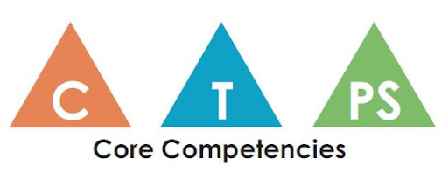
Turn & Talk
Where in Number Talks are you seeing the core competencies, curricular competencies, and content?

Slide 15
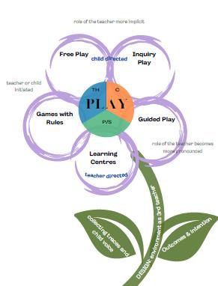
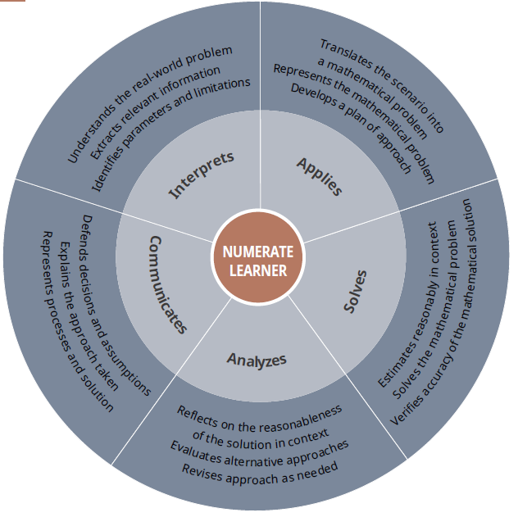
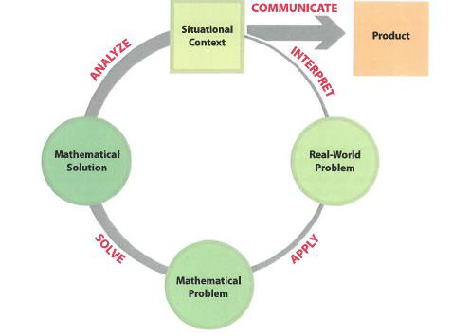
SD71 Numeracy Framework Numeracy Foundations
Early Years
Play
Relationship
Community of Mathematicians
Rich Numeracy Tasks
Skills and strategies:
Intermediate/Middle Years
Problem Solving
Collaboration
Mathematical Community
Rich Numeracy Tasks
Structures and Routines
Skills and Strategies
Graduation Years
Collaboration
Community of Problem Solvers
Rich Numeracy Tasks
Structures and Routines
Skills and Strategies

Slide 16
Why Use Number Talks
To improve flexibility and real understanding of numbers and arithmetic procedures which will help build a solid foundation for future math learning.
To empower students as mathematical thinkers by assigning value to the ideas in the room
To build number sense! This is the foundation of algebra!!!
To encourages thinking about patterns, quantities and the relationships between numbers
Supports the building of mathematical language
Supports student’s growth in explaining, justifying, reasoning, and communicating
Develops mental math strategies
Promotes mathematical habit of mind (perseverance, value that mistakes are an opportunity to discover and learn, recognizing that there are multiple ways to solve a problem, building a toolbox of strategies and tools, respecting diversity in different approaches)

Slide 17
Tips for Success
Start with visuals (dot cards, ten frames etc.) to get kids comfortable in the routine
To be effective it needs to done regularly (every day at first and then move to a few times a week)
There are ways to make it interesting and differentiate (white boards, sharing at groups, whole group, small group etc.)
Don’t try to wing it!

Slide 18
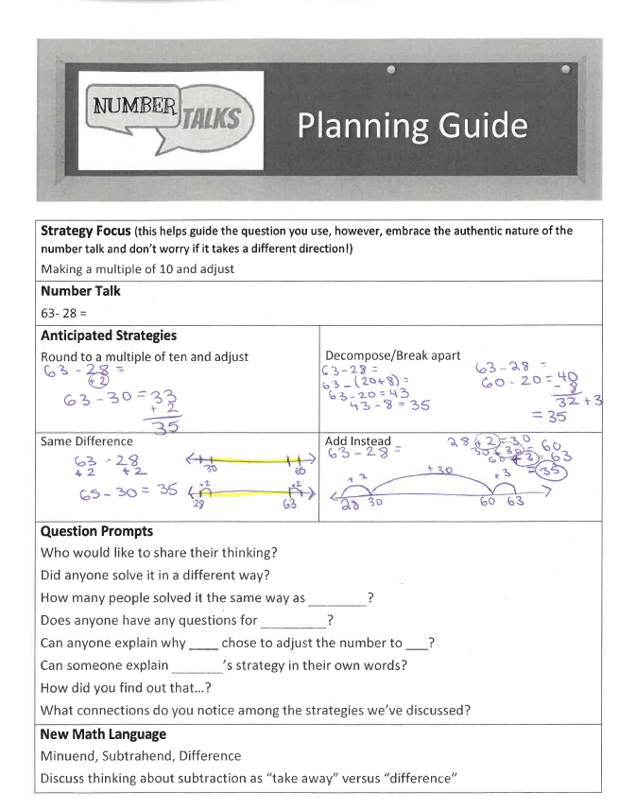
Planning a Number Talk

Slide 19
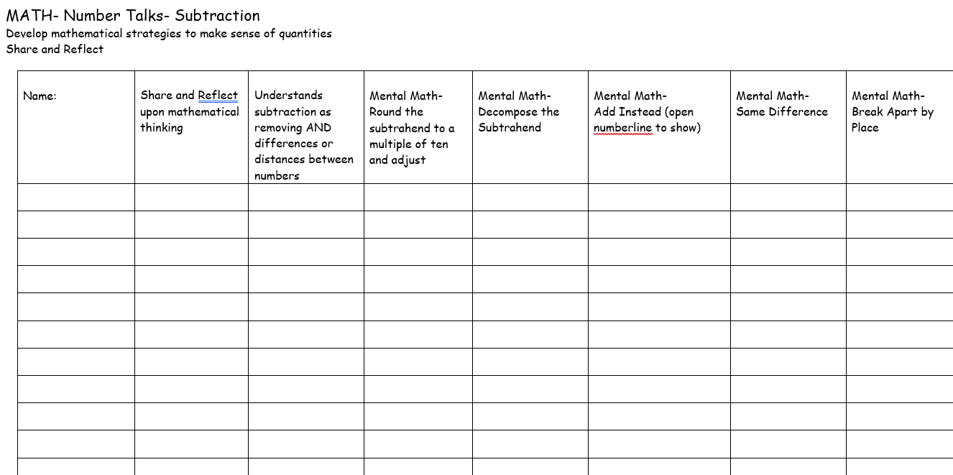
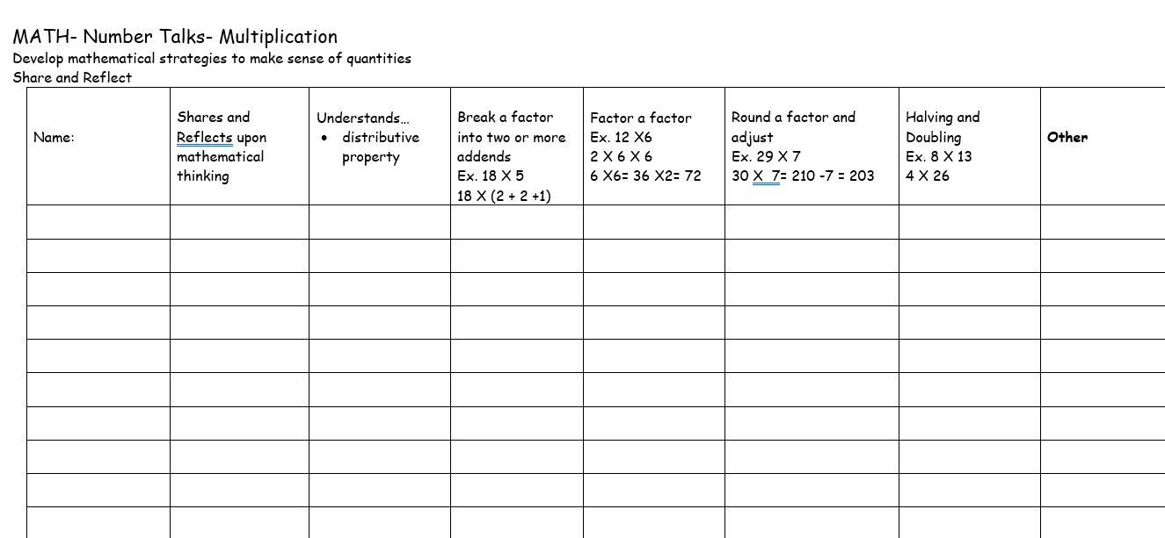
Assessment Ideas
Strategy Checklist on Clip Board
Small Group Number Talk Conferences
Pictures of Board after a Number Talk
Have them make their own number talk on video
Written Activity and Reflection on their strategy work

Slide 20
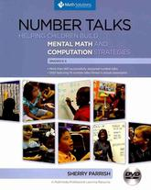
Resources
Number Talks-
Sherry Parrish
Making Number Talks Matter-
Cathy Humphreys and Ruth Parker
Number Talks in the Primary Classroom-Kathy Richardson and Sue Dolphin
http://www.meaningfulmathmoments.com/number-talks.html
https://www.youcubed.org/resource/number-sense/
https://stevewyborney.com/2017/02/splat/

Slide 21
Contact Info
alex.sabell@sd71.bc.ca
serina.allison@sd71.bc.ca

