Slide 1





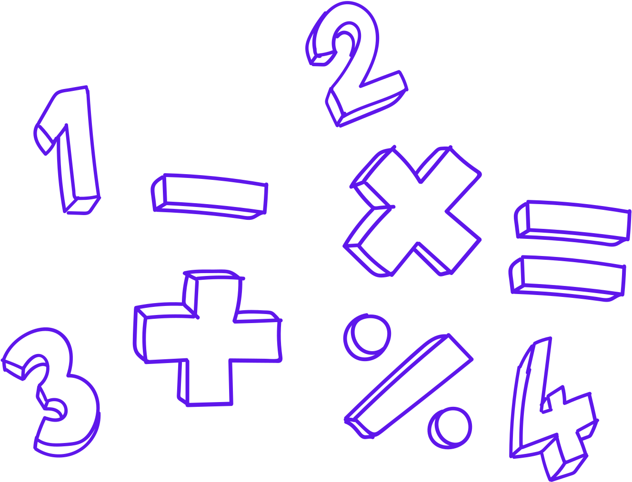
Monday Math Moments
M³
High Yield Math Routines to support,
flexible thinking, fluency
&
build strong mathematical communities
Co-created by Serina Allison & Jennifer Yager

Slide 2
What are high yield math routines
  Consistent 5-15 minute classroom routine
  A routines that engages mental math strategies
  The focus is on Mathematical discourse and the justification of strategies
  Teacher acts facilitator and recorder
Co created by Jennifer Yager & Serina Allison

Slide 3
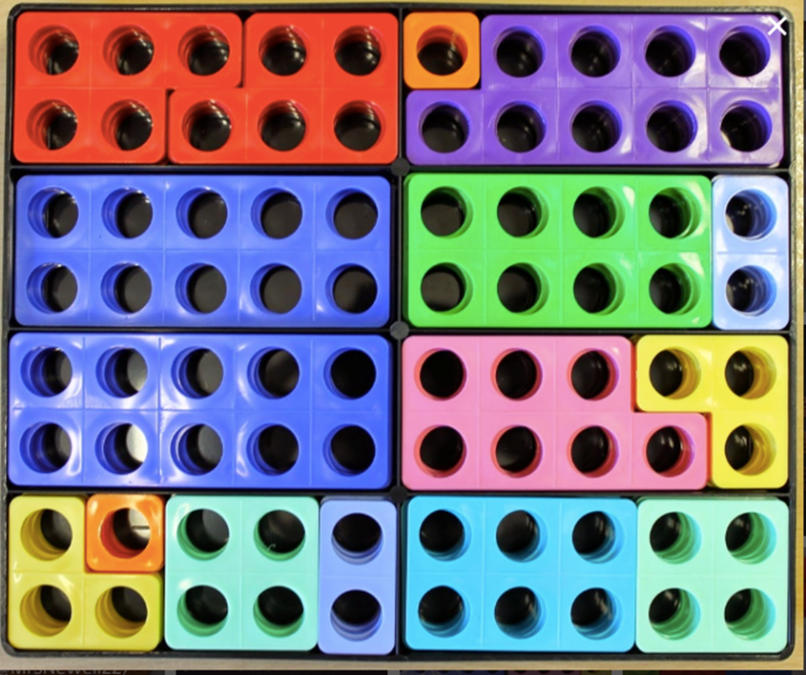
Number Talk Images
What do you notice?
How many?
How do you see them?
Co created by Jennifer Yager & Serina Allison

Slide 4
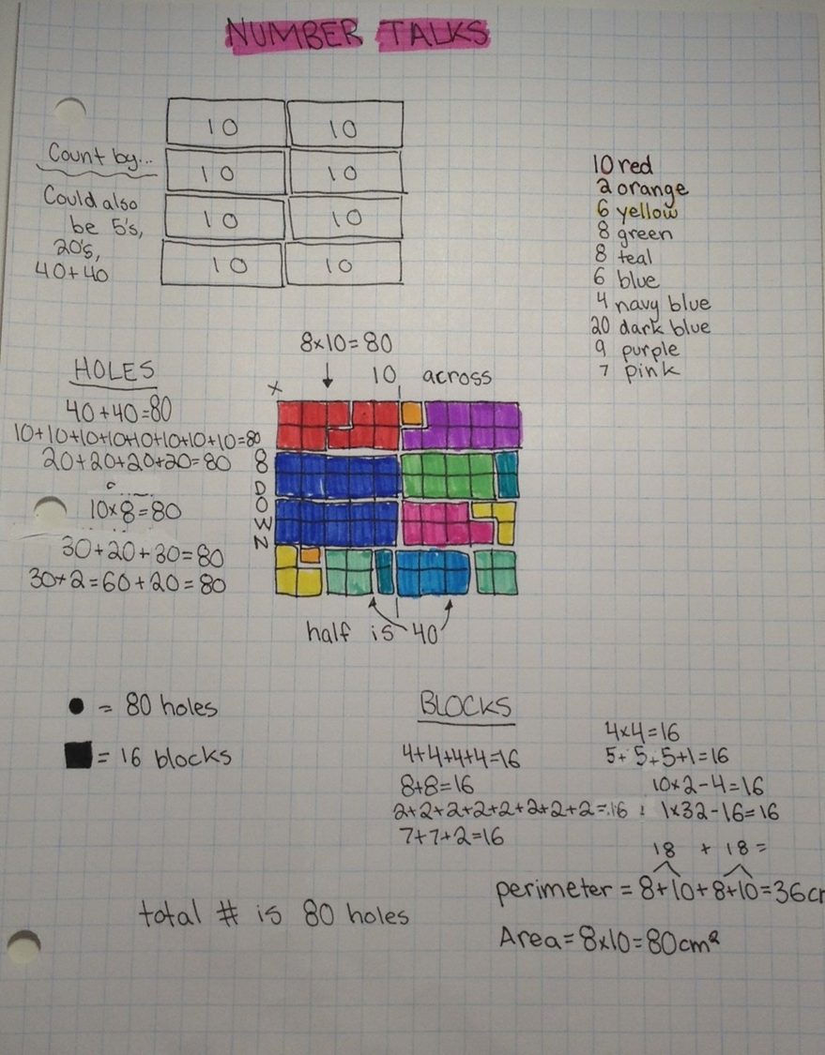
Co-created by Serina Allison & Jennifer Yager

Slide 5
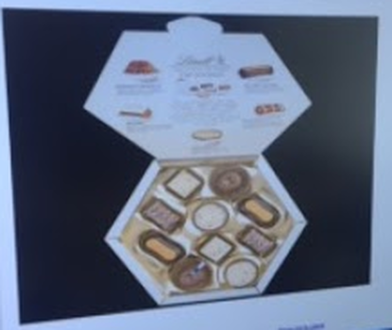
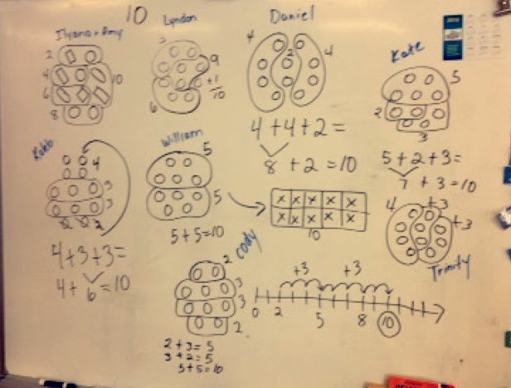

Slide 6
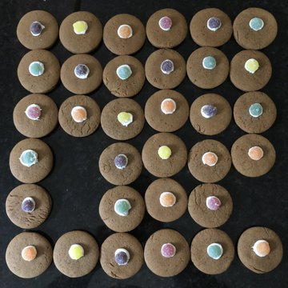
Missing Part Arrays
What do you notice?
How many are there?
How do you know?
How many are missing?

Slide 7
Invite students to make their own Number Talk Images
  Share with peers in small groups
  Bring home to do with their family

Slide 8
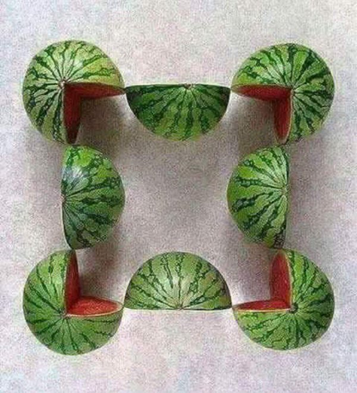
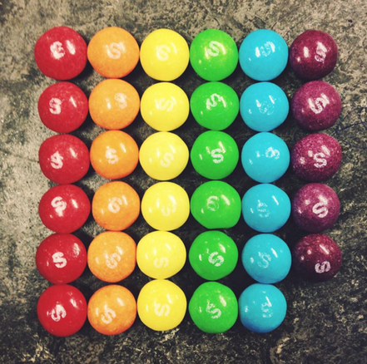

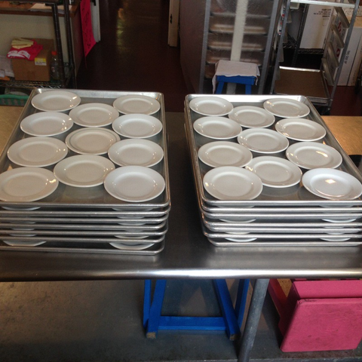
Number Talk Collections- weebly
More Number Talk Collections
Richmond-SD38:
Video Number Talk Images
Co-created by Serina Allison & Jennifer Yager

Slide 9
Why implement high yield routines in my class today?
  Fosters community with a focus on many of the core competencies
  Honour’s student voice and learning from each other.
  Engages all students by providing an entry-point for all students
low floor-high ceiling.
  Provides an opportunity to build mathematical vocabulary, discourse and critical thinking.
  Focuses on the big ideas of mathematics.
  Gives students an opportunity to practice visualization.
  Builds mental math strategies leading to confidence and greater computational fluency.
  They are short, quick and impactful on student learning.
Co created by Jennifer Yager & Serina Allison

Slide 10

Monday Math Moments
M³
serina.allison@sd71.bc.ca

