Slide 1





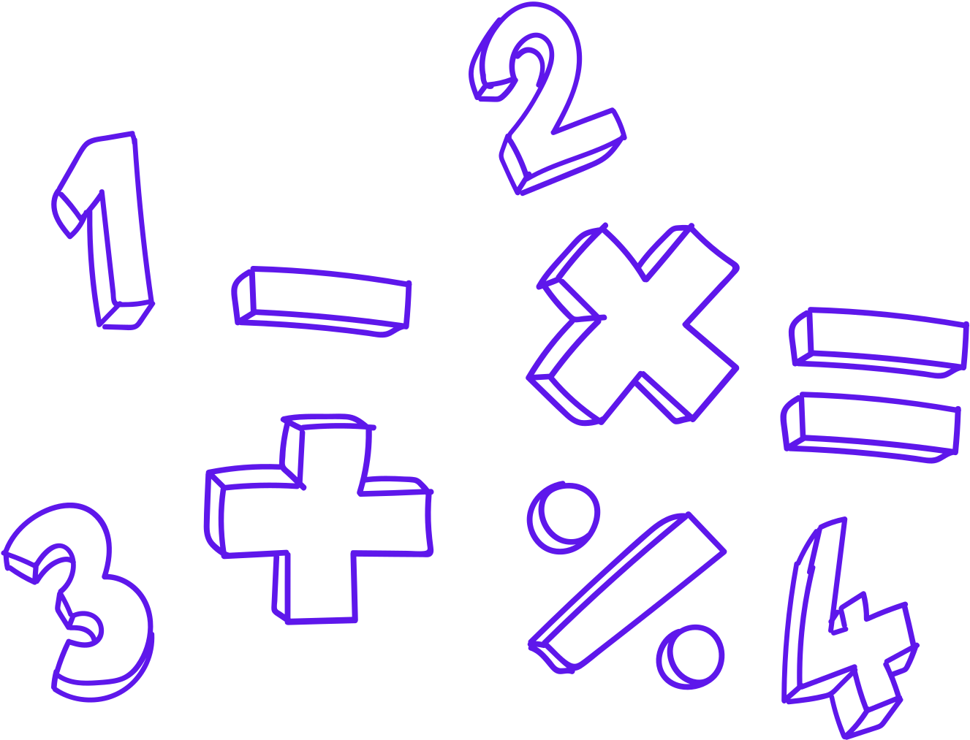
Monday Math Moments
M³
High Yield Math Routines to support,
flexible thinking, fluency
&
build strong mathematical communities

Slide 2
High Yield Numeracy Routines
• 5-15 minute classroom routine
• Focused on thinking, learning and communication
• Developing mental math strategies and computational fluency that builds from understanding number relationships
• Teacher as facilitator and recorder
• Mathematical discourse and justification of solutions and strategies
  A foundation to building a strong and safe mathematical community with our learners.
Co created by Jennifer Yager & Serina Allison
M³ Monday Math Moments

Slide 3

DOTS
How many?
How do you see them?
Dot images
Quick Images
Quick Images- Dots – Instructional Video’s and printables
Dot Card Pintables
Co created by Jennifer Yager & Serina Allison
M³ Monday Math Moments

Slide 4


Slide 6
DOTS
How many?
How do you see them?
Dot images
Quick Images
Quick Images- Dots – Instructional Video’s and printables
Dot Card Pintables
Co created by Jennifer Yager & Serina Allison
M³ Monday Math Moments

Slide 7
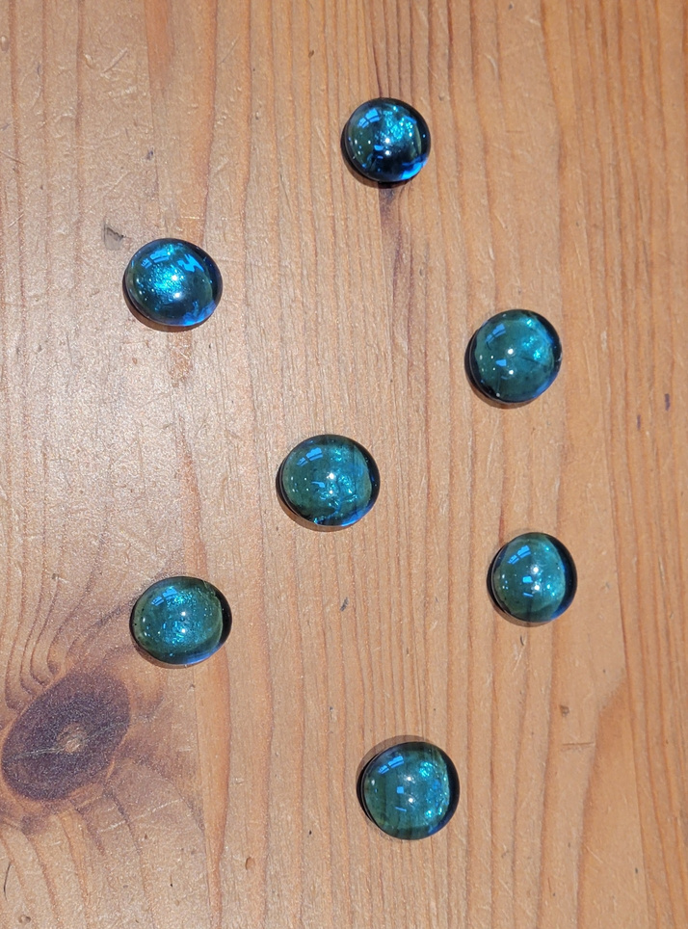
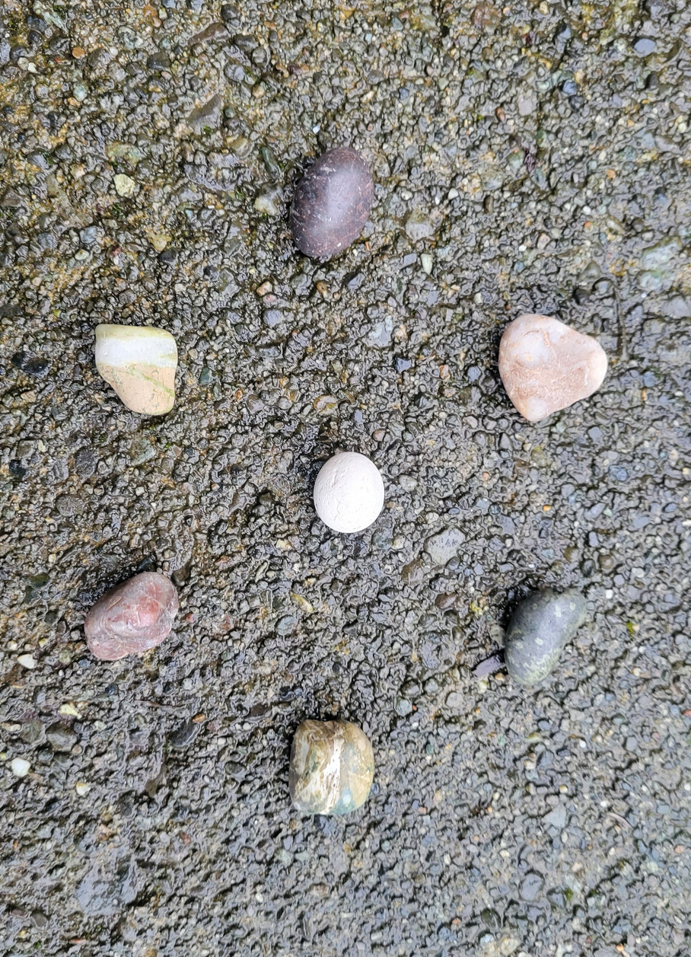

Slide 8
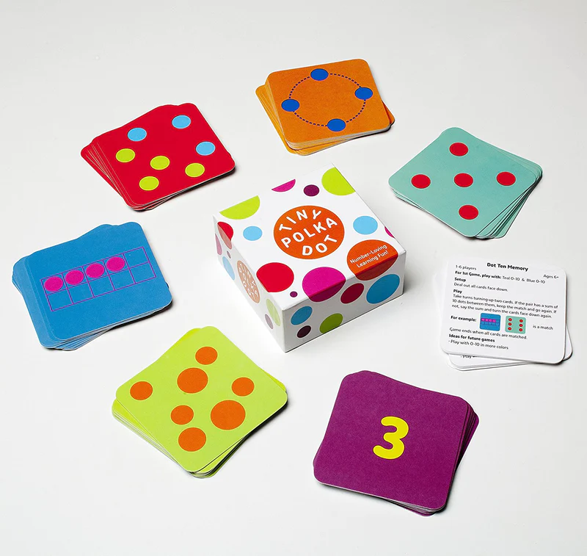
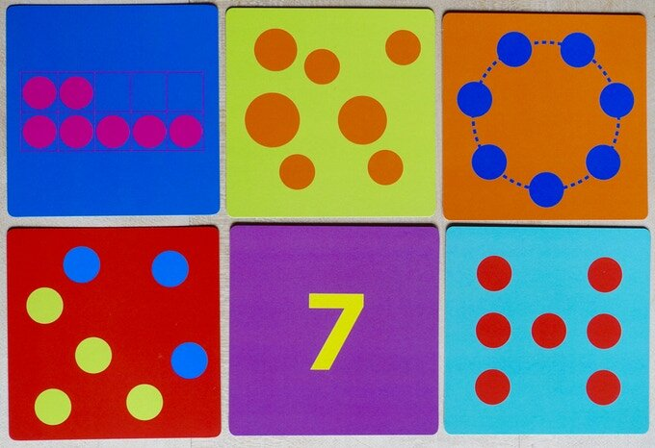
Tiny Polka Dot Game
Tiny Polka Dot Game- Resources- Math for Love
Quick Images- Dots – printables
More Printables & Instruction Videos - Young Mathematicians
Co created by Jennifer Yager & Serina Allison
M³ Monday Math Moments

Slide 9
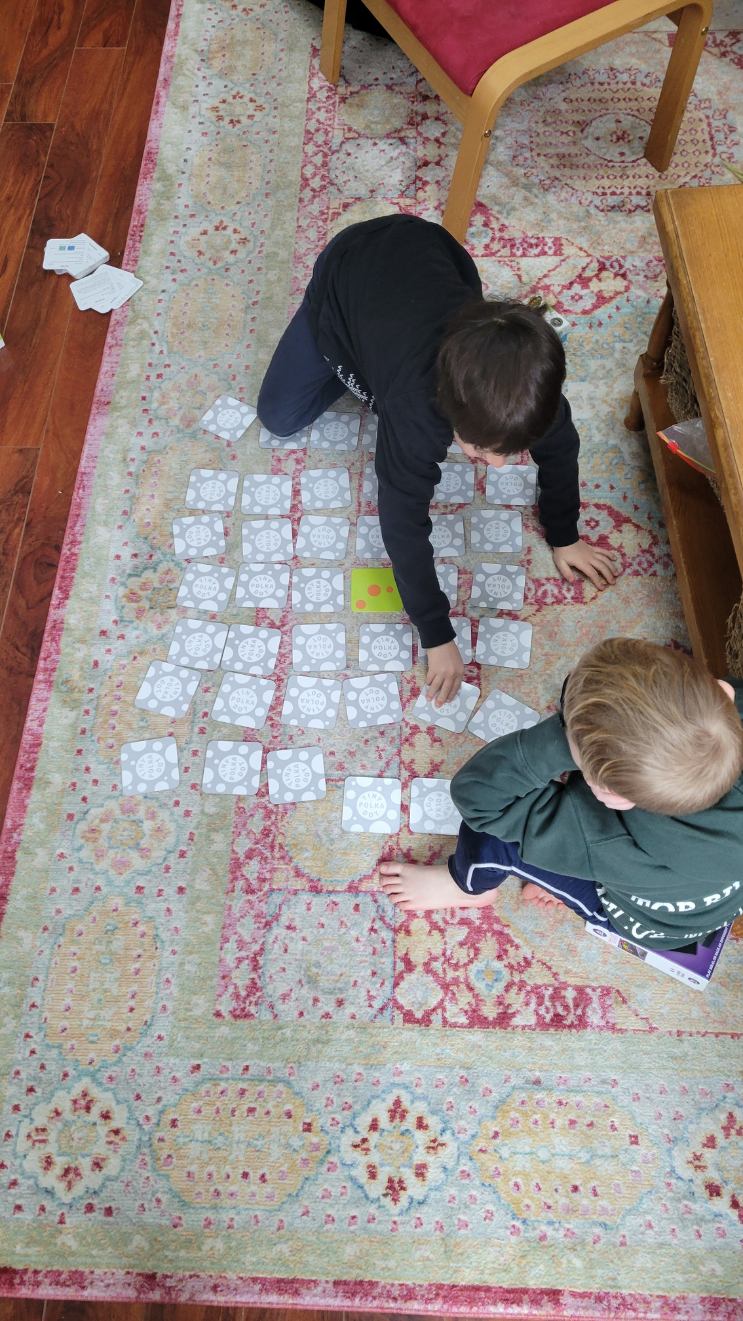
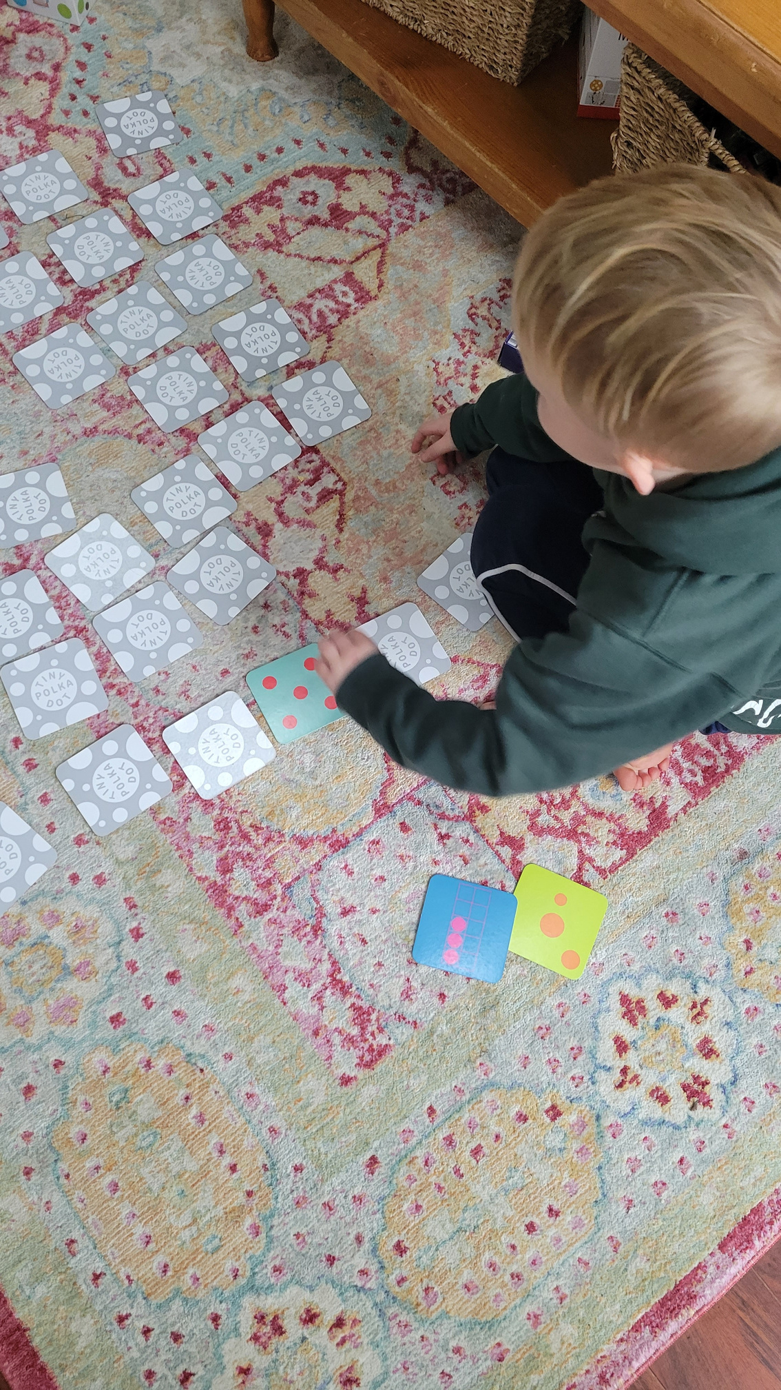

Slide 10
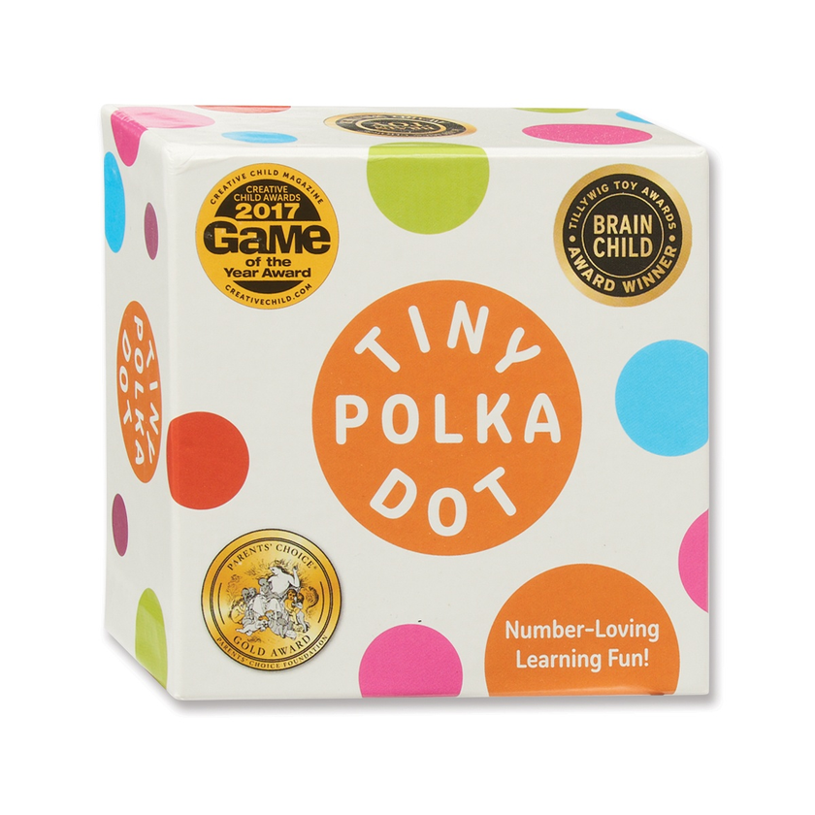
Tiny Polka Dot Game
  Number names
  Number order to five
  One to one correspondence — knowing each successive number name corresponds to one more when counting
  Conservation of number — recognizing that objects in different arrangements can still represent the same number
  Number order to ten and beyond
  Subitizing — the ability to recognize the number of objects in a small collection without having to count
  Understanding addition as combining and subtraction as taking away
  Addition to five
  Addition to ten
  Subtraction to five
  Subtraction to ten
  Addition and subtraction to twenty and beyond
Tiny Polka Dot Game- Resources
Quick Images- Dots – Instructional Video’s and printables
Co created by Jennifer Yager & Serina Allison
M³ Monday Math Moments

Slide 11
DOTS
How many?
How do you see them?
Dot images
Quick Images
Quick Images- Dots – Instructional Video’s and printables
Dot Card Pintables
Co created by Jennifer Yager & Serina Allison
M³ Monday Math Moments

Slide 12

Monday Math Moments
M³
serina.allison@sd71.bc.ca

