Slide 1
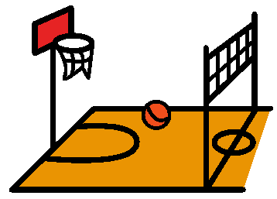
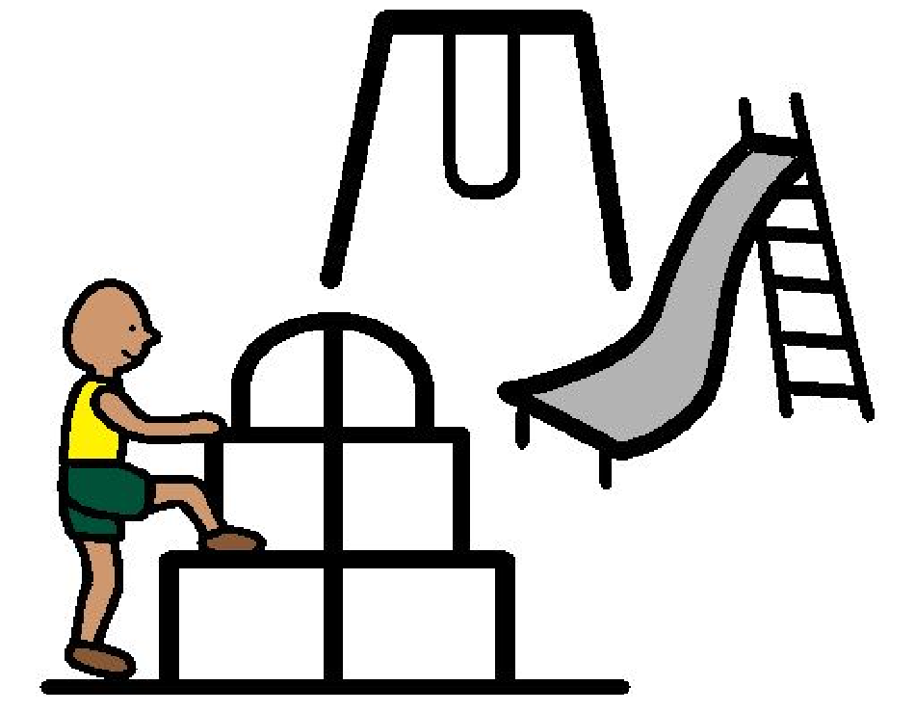
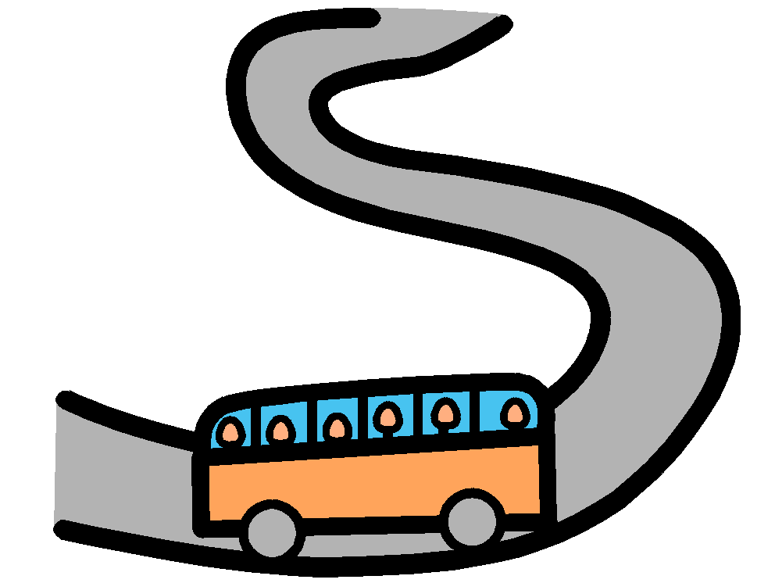
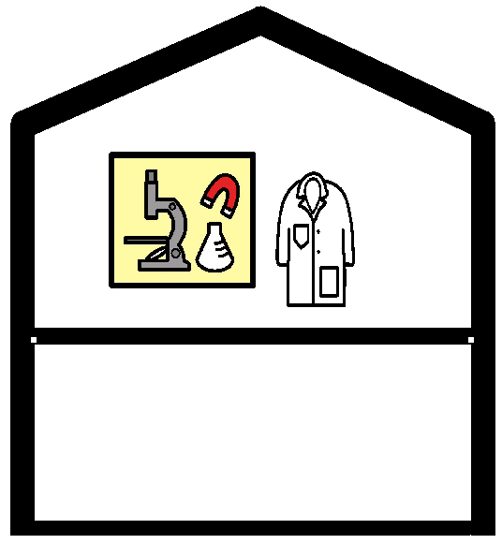
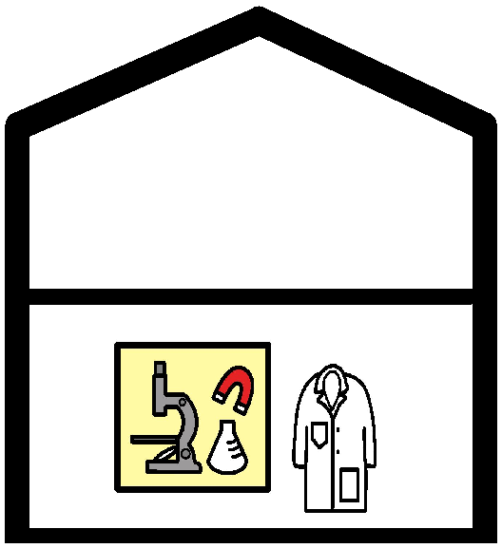
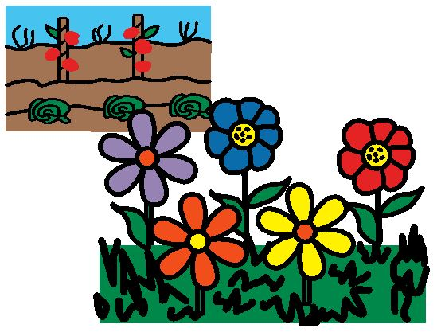
WHERE ARE WE?
Gym
Playground
Library
Forest
Upper Lab
Field Trip
Music Room
Lower Lab
Project Room
Garden

Slide 2
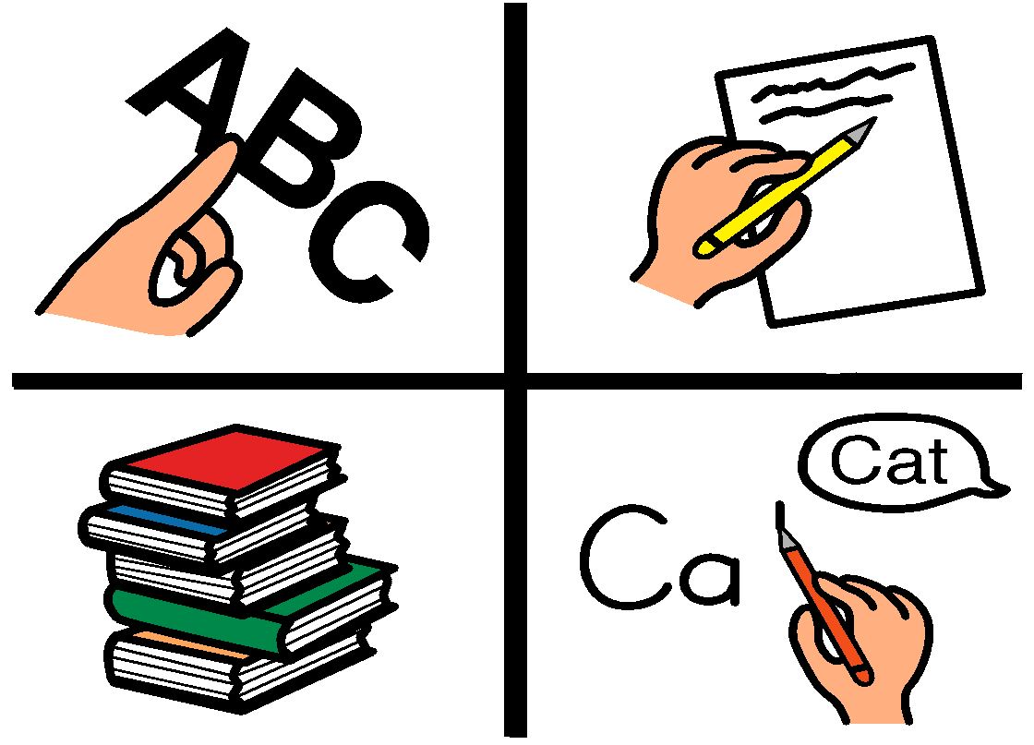
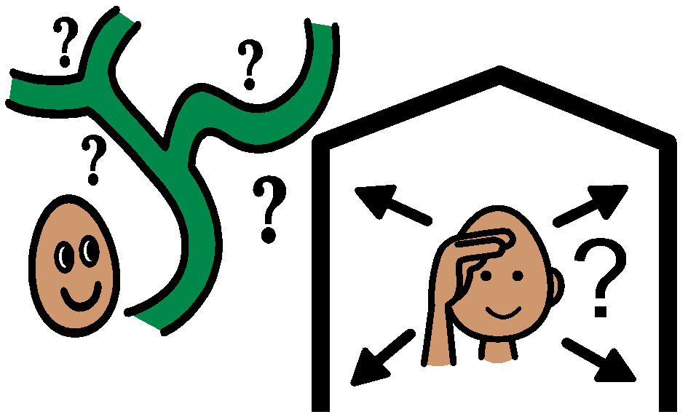
WHERE ARE WE?
Library
Gym
Music
Literacy
Project Room
Forest
Playground
Field Trip
All Over The Place
HERE
Text

Slide 3
We are in the …
Project Room
Library
Upstairs
Computer
Lab
Downstairs
Computer
Lab
Music Room
Gym
Playground
Forest
Field Trip
Garden

Slide 4
We are in the …
Project Room
Library
Upstairs
Computer
Lab
Downstairs
Computer
Lab
Music Room
Gym
Playground
Forest
Field Trip
Garden

Slide 5
We are in the …
Project Room
Library
Upstairs
Computer
Lab
Downstairs
Computer
Lab
Music Room
Gym
Playground
Forest
Field Trip
Garden

Slide 6
We are in the …
Project Room
Library
Upstairs
Computer
Lab
Downstairs
Computer
Lab
Music Room
Gym
Playground
Forest
Field Trip
Garden

Slide 7
Division is in the ….
Library
Gym
Music
Playground
Forest
Away on Field Trip

Slide 8
Division is in the ….
Library
Gym
Music
Playground
Forest
Away on Field Trip

Slide 9
Division is in the ….
Library
Gym
Music
Playground
Forest
Away on Field Trip

Slide 10
Division is in the ….
Library
Gym
Music
Playground
Forest
Away on Field Trip

