Slide 1
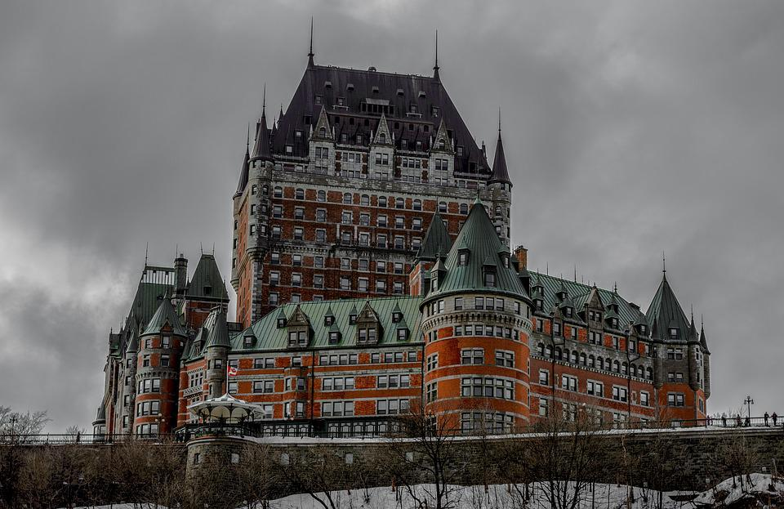
Le Carnaval de Québec
Cultural Study:

Slide 2
Le Vocabulaire
Carnival - le carnaval
Le Bonhomme Carnaval
costume - un costume
parade - un défilé
canoe - un canot
Queen - une reine
ice - la glace
ice palace - le palais de glace
ice sculpture - une sculpture de glace
race - une course
Saint Lawrence River - le (fleuve) Saint-Laurent
hockey tournament - le tournoi de hockey
snowshoes - les raquettes
fireworks - les feux d'artifice

Slide 3
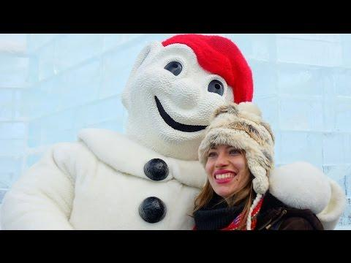
Background
Write a few sentences about what you know about celebrations and holidays.
Watch the following video and answer the questions below.
CARNAVAL DE QUÉBEC | Quebec City Winter Carnival
Questions:
Where Does Carnival take place?
Le Carnaval de Quebec is the ____ winter carnival in the world.
Name five activities that you see
Of all the activities that you see which would you like to try? Why?

Slide 4
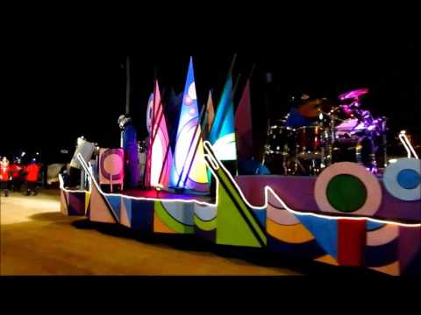
Activité 1: Le Defile de Nuit
The opening of Carnaval starts with a beautiful Parade called "le defilé de nuit". Watch the video of the parade and answer the questions below.
What colours did you see in the parade? Name them in French.
Why do you think the parade happens at night?
Translate these words into English:
les personnes =
Les musiciens =
Le chocolat chaud =

Slide 5
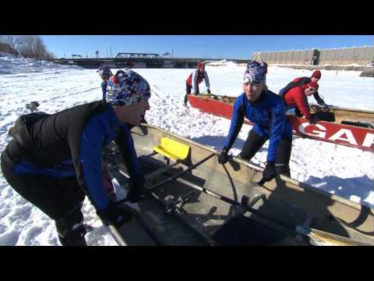
Activité 2: La course de canots
Watch the video on la course de canots with Rick Mercer. Answer the questions below.
Questions:
On which river does the Canoe race take place?
How far back does the race go? It started before Quebec had what?
What do they add to their soccer cleats?
How many people are on each team?

Slide 6
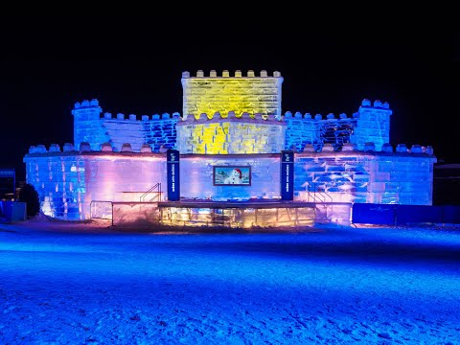
Activité 3: Le palais de glace
Watch a video about the ice-sculpting and the construction of the Palais de Glace.
The video is in French, so you need to observe carefully the tools the sculptors use.
Make a list of all the tools you see the workers use. Try and find at least 6.

Slide 7
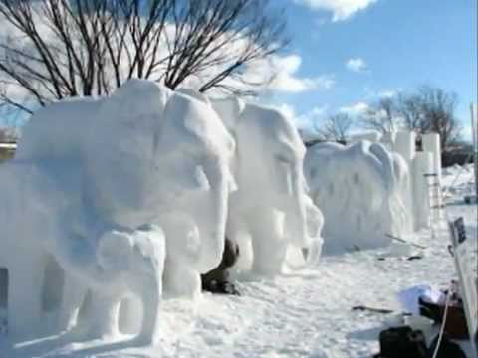
Activité 4: Les sculptures de neige
Watch the videos about the snow sculptures and answer the questions below.
Questions:
Which statue is your favourite?
Why is that one your favourite?
Which do you think is the hardest to make? Why?
What would you make if you were there?

Slide 8
Enrichment: Le journal
For each activity, you will describe some of the events that you see at the Carnaval. In your entry you must include 2 of the vocabulary words for the Carnaval unit and one food item.
Here are the sentence starters you should use:
Aujourd'hui j'ai vu Today I saw
Aujourd'hui j'ai fait Today I did
J'ai mangé I ate
For example:
Aujourd'hui j'ai vu la palace de glace avec Bonhomme. J'ai fait le rafting sur neige. J'ai mangé les queues de castor.
For each sentence, include an image.

Slide 9
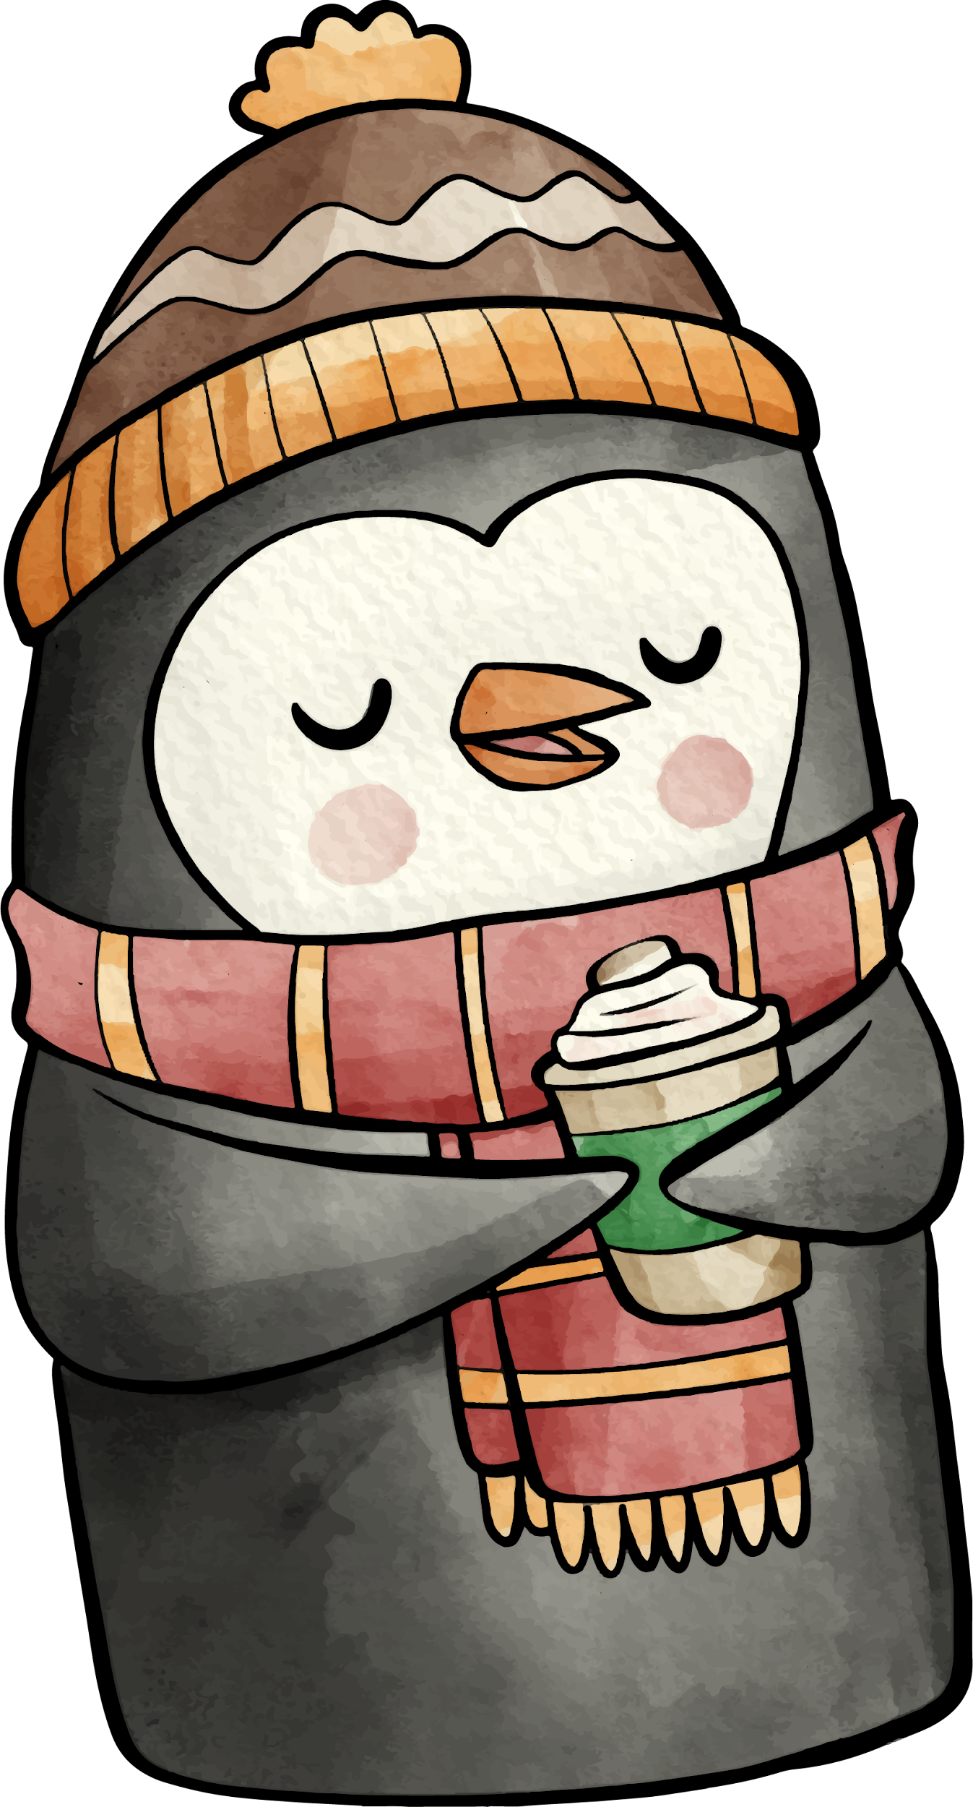
Merci à Noah Burdett for sharing this project!

