Slide 1
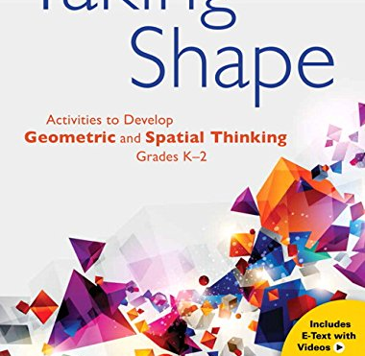
Spatial Reasoning
Square Tiles

Slide 2
Notice carefully the placement of the square tiles.
Study the image for 3 seconds.
Create the design on your hundred grid as you see it.
Check, check, double check ! How did you do? Where are tiles placed on the line of symmetry?

Slide 3
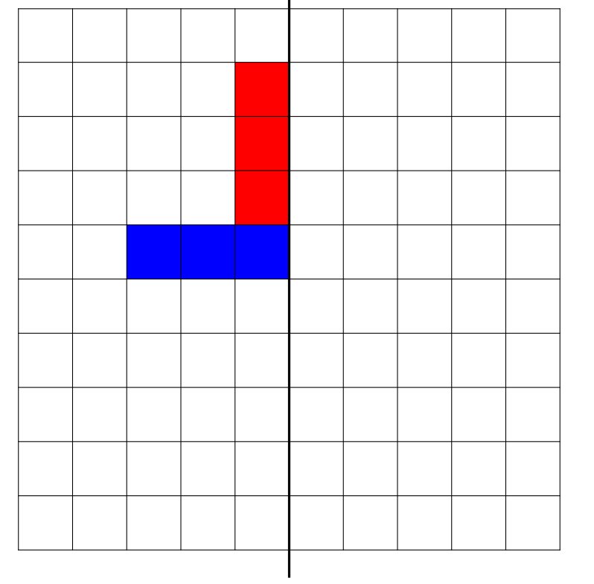

Slide 4
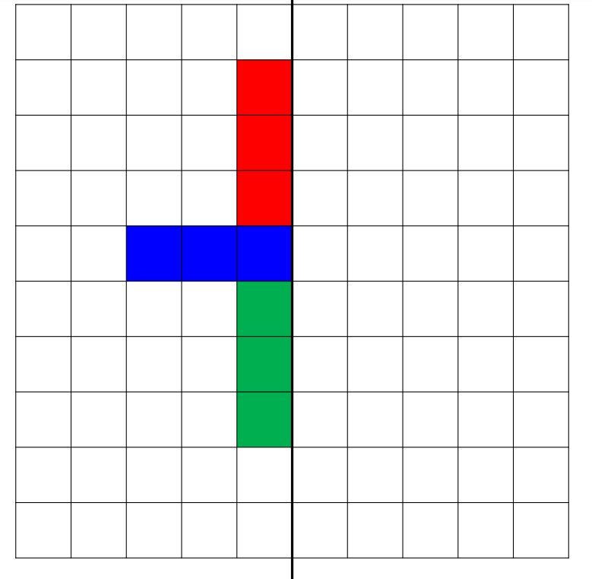

Slide 5
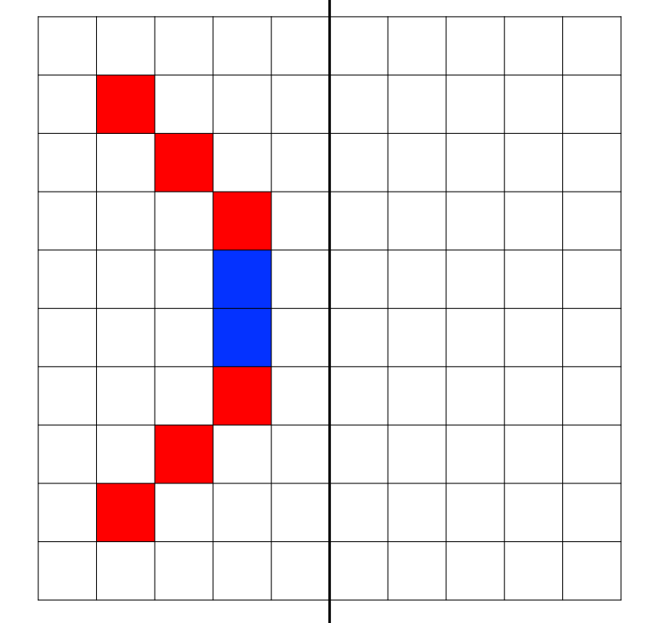

Slide 6
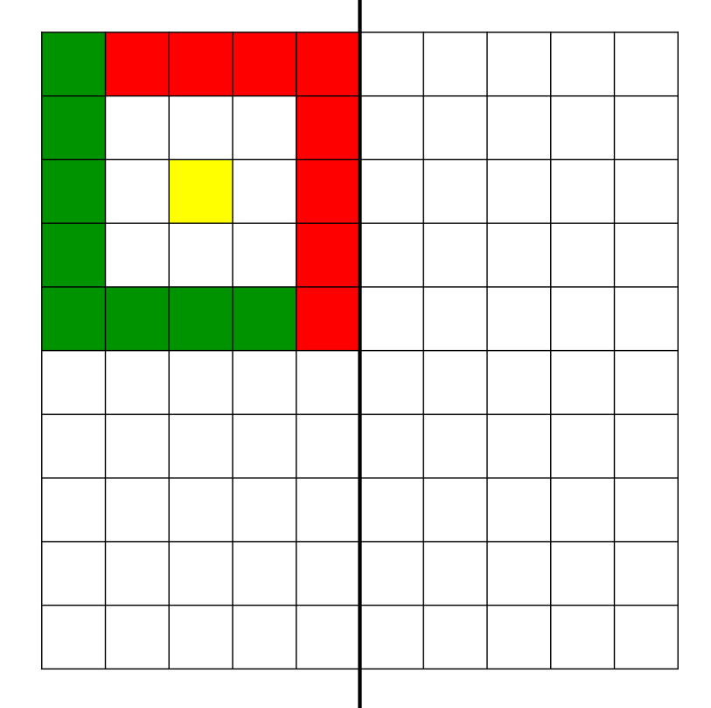

Slide 7
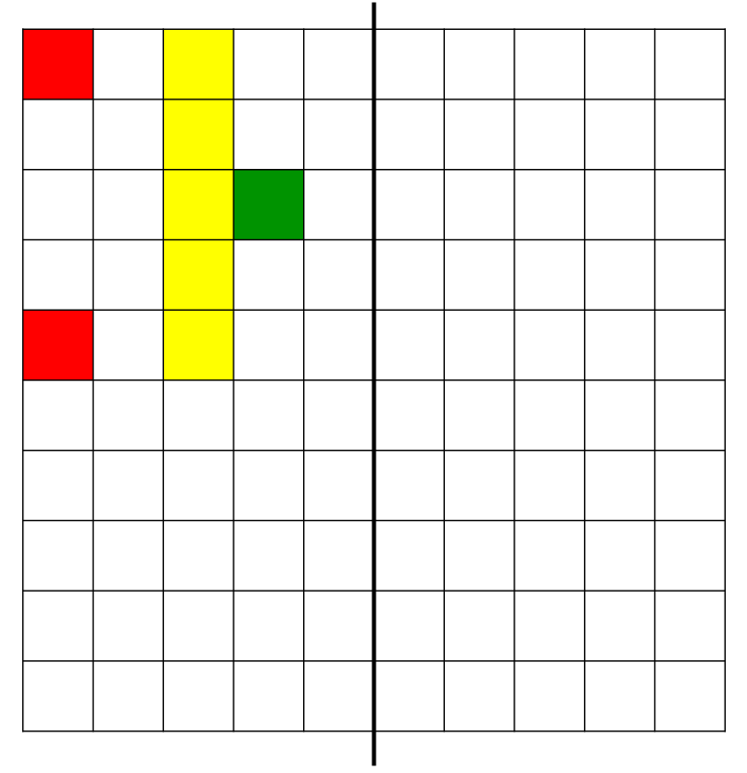

Slide 8
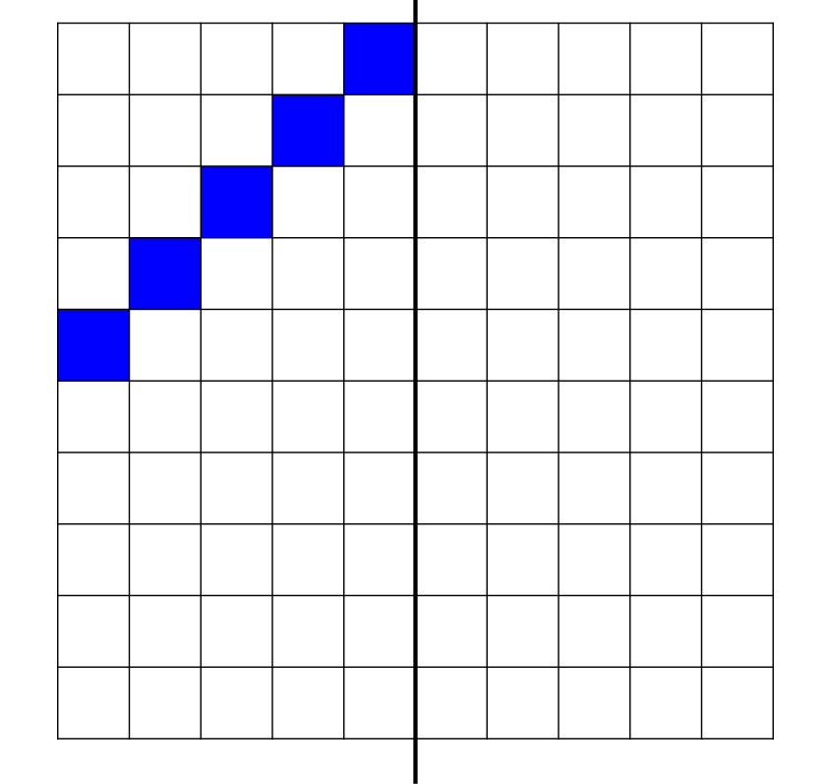

Slide 9
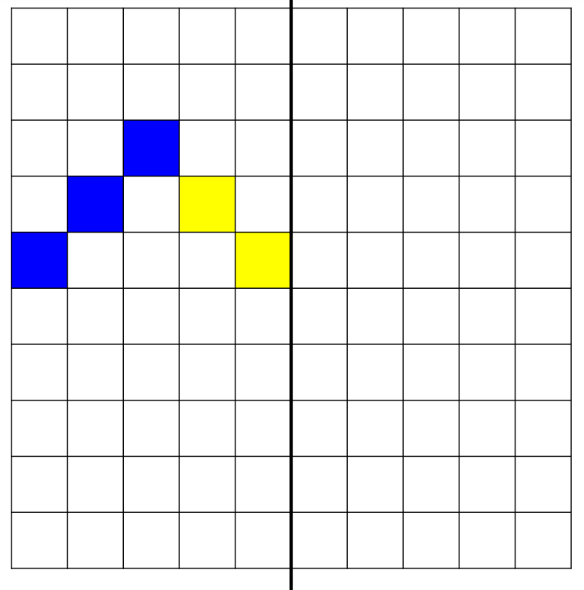

Slide 10
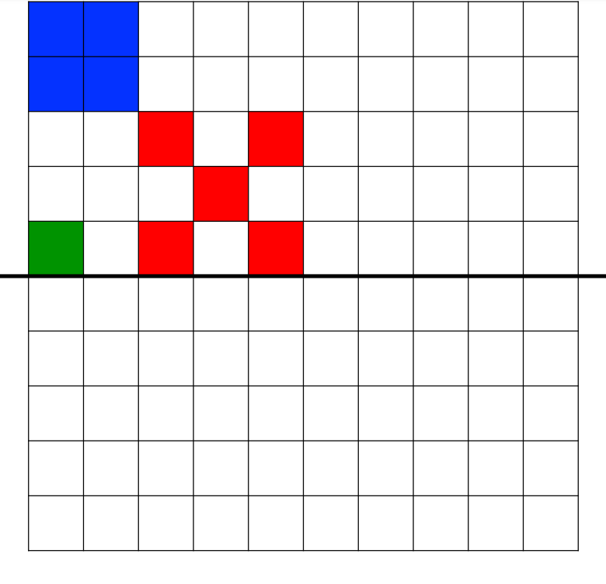

Slide 11
Reposition your line of symmetry to be horizontal now

Slide 12
