Slide 1
Number Concept Map
Representations to show Number Sense

Slide 2
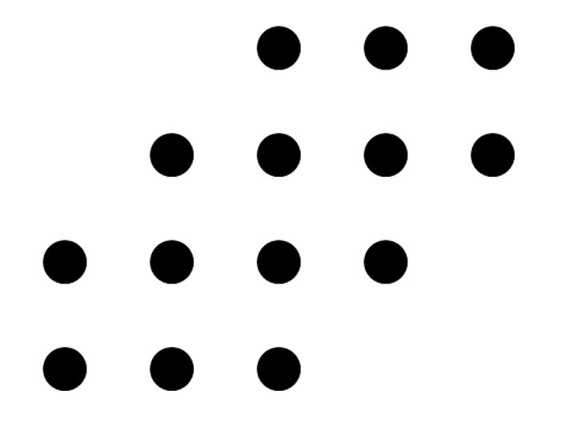

Slide 3
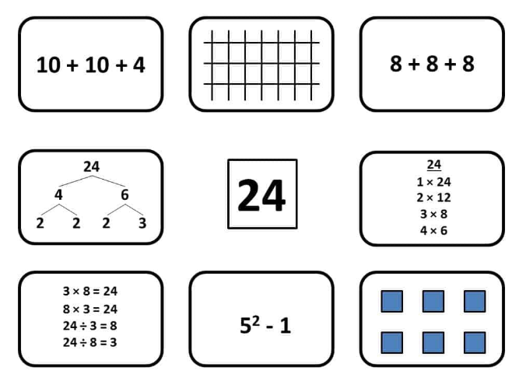

Slide 4
Building our number sense
It is all about relationships.
What relationships do you see in one another's ideas?

Slide 5
