Slide 1
The Reading Brain
Heather Willms
Reading Support Teacher - Comox Valley Schools

Slide 2
What is the brain designed to do?

Slide 3
What the brain is not designed to do…

Slide 5
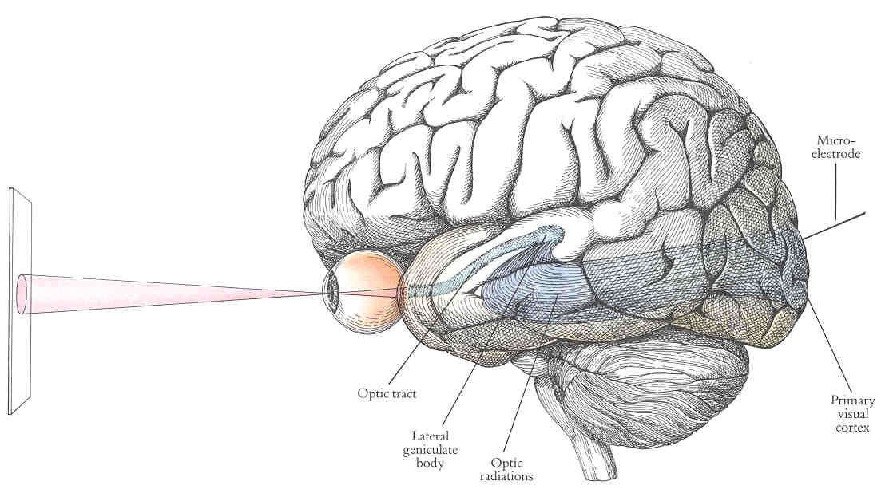
Visual cortex

Slide 6
Auditory cortex

Slide 7
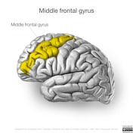
Inferior frontal gyrus

Slide 8
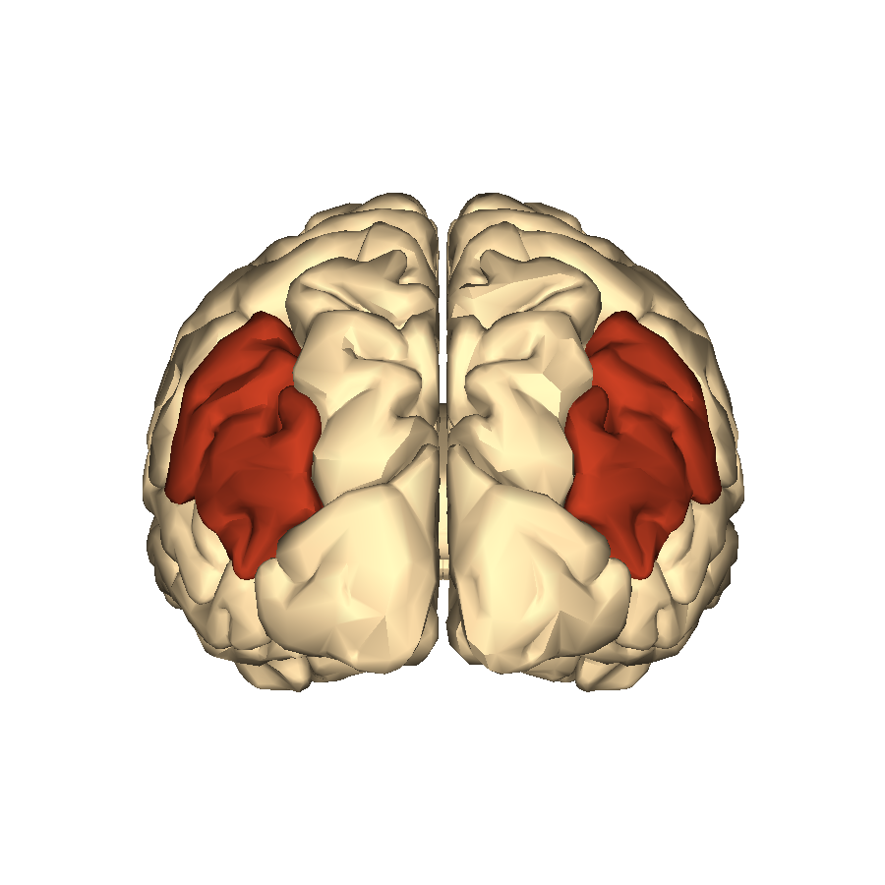
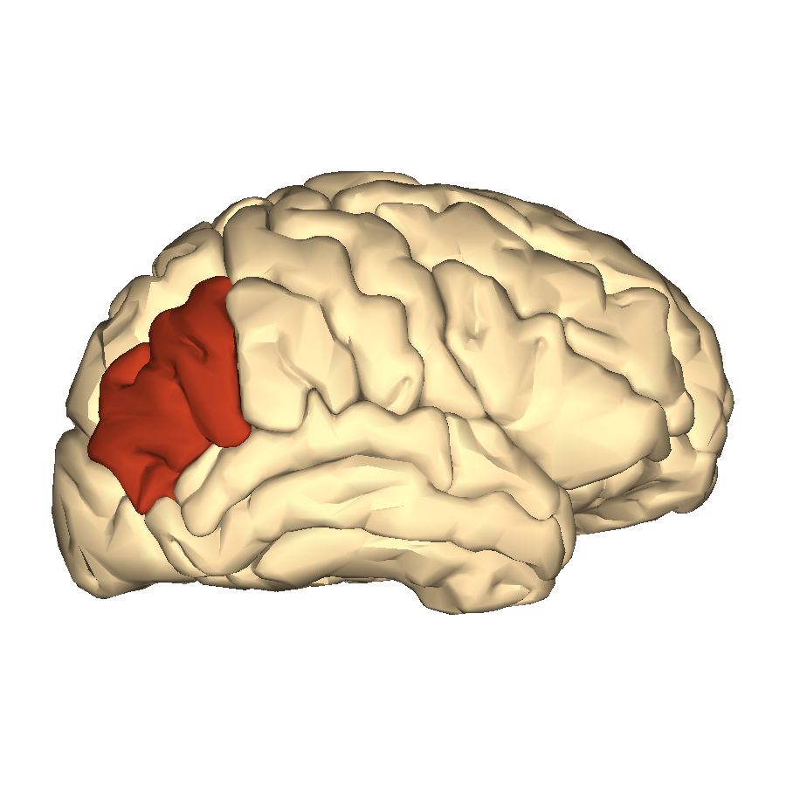
Angular gyrus

Slide 9
Building pathways

Slide 13
Learning to read + Fast = smart?

Slide 14
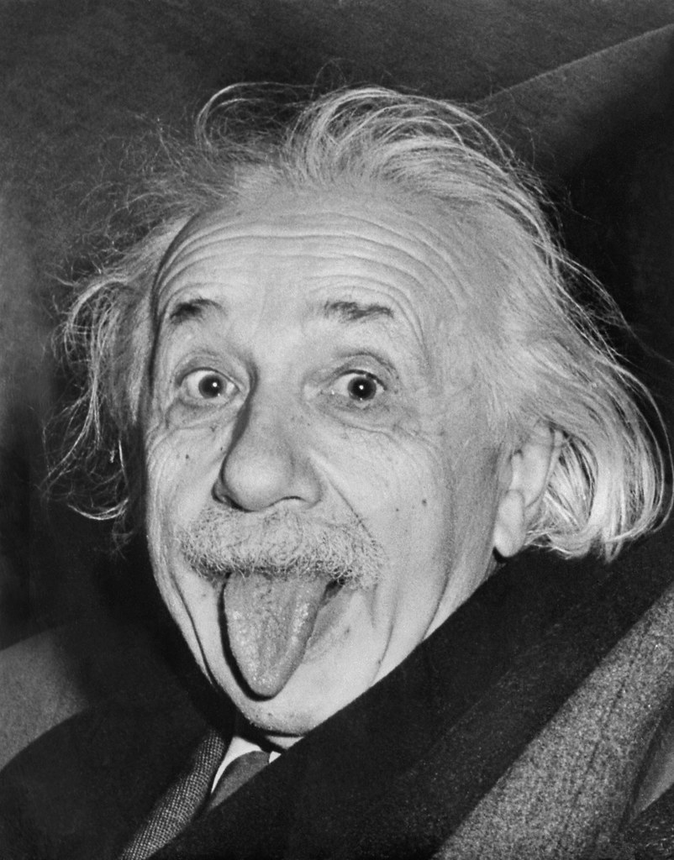
Brilliant people who had a hard time learning to read

Slide 15
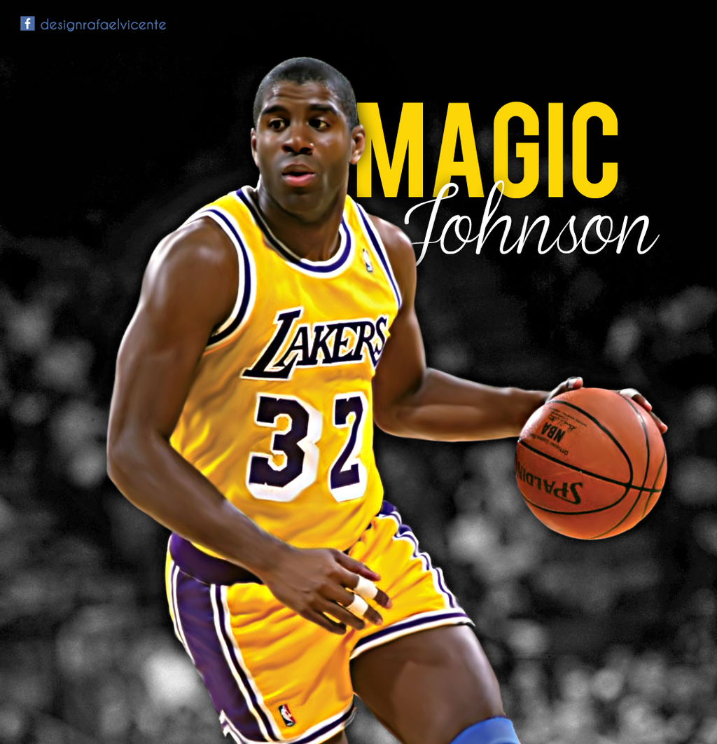
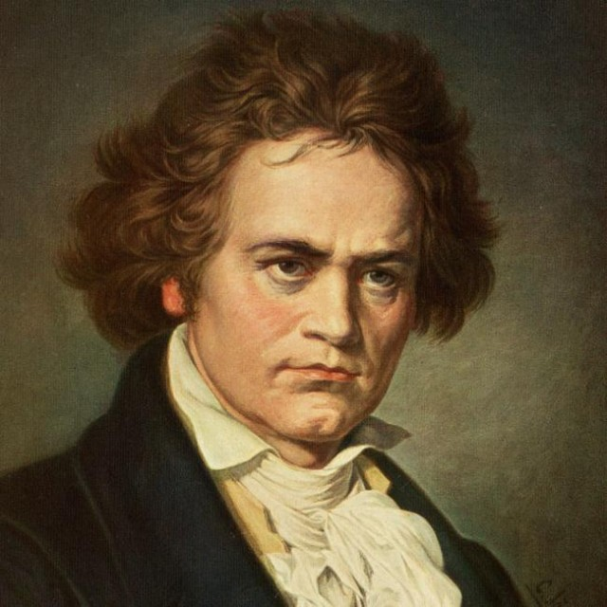

Slide 16
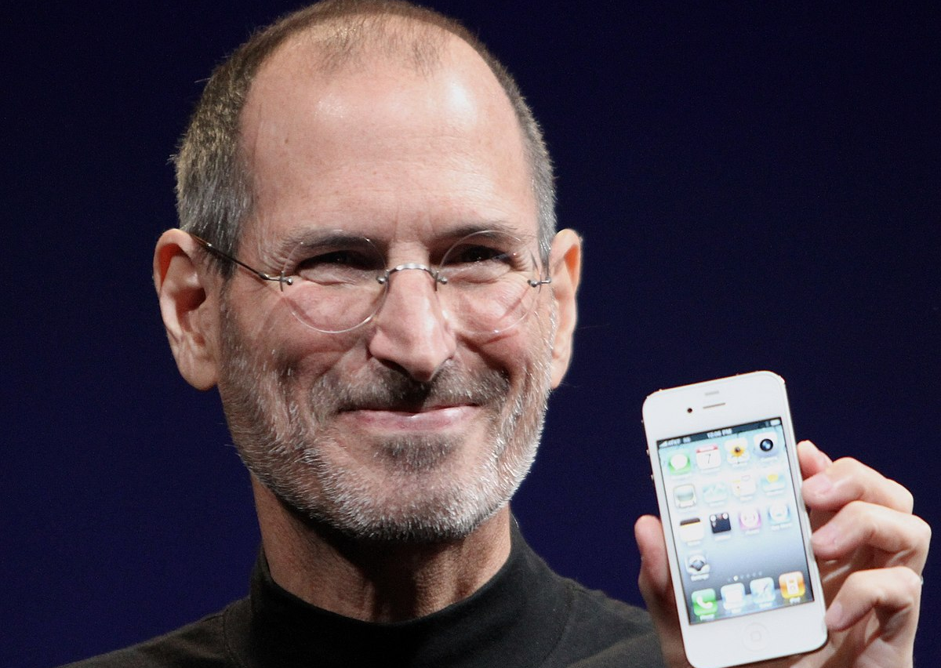
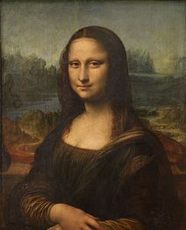

Slide 17
