Slide 1
Six Step Overview of How to Create Multimedia Videos On a Computer

Slide 2
Learning Intentions:
Learn steps in creating a multimedia video
Tips on how to film video clips
Tips on how to import video clips

Slide 3
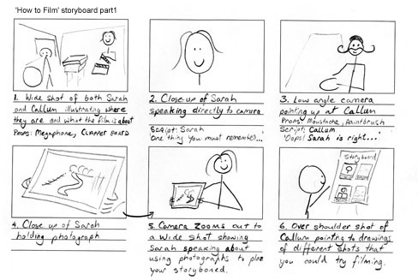
First Easy Step: Create a storyboard

Slide 4
Second Easy Step: Film video footage needed
Write a script (if needed)
Collect props first
Where are you filming? (background is important)
Practice lines, choreography, etc.
Use a tripod if possible to avoid camera shake
Check sound quality – do a test video first?

Slide 5
Third Easy Step: Upload footage
Take memory card out of camera and insert into computer/laptop
*Sometimes an adapter needed
Find the video file(s)
Copy and paste to a folder on your computer or flashdrive
Best to do this directly after filming

Slide 6
Fourth Easy Step: Use movie making program to create video
import video clips into the movie making program from the folder where you saved them (see previous slide)
Edit video clips if needed and if possible (depends on the program)
Import or add music
Add titles/captions

Slide 7
Fifth Easy Step: Citing
Cite your sources at the end of the video
Give credit to the videographer
Cite sources for royalty/copyright free videos

Slide 8
Sixth Easy Step: Saving/Publishing
Major difference between saving and publising
Save as a working document
‘Save’ or ‘Save as’ to work on it again
Finished movie file (generally ‘Publish)
Can be opened on most devices as a movie file (e.g. .mov or .avi)

Slide 9
Final Tips:
Leave all video, photo and audio files in the same place you imported them from until the movie is published as a m.
MUST “Publish” movie to view on other computers If using Movie Maker, look for Youtube tutorials like this:
Getting Started Tutorial - Windows Live Movie Maker

