Slide 1
Math and Equation and Symbols Tools for Word Desktop version
Student Services Comox Valley Schools
Feb 2021

Slide 2
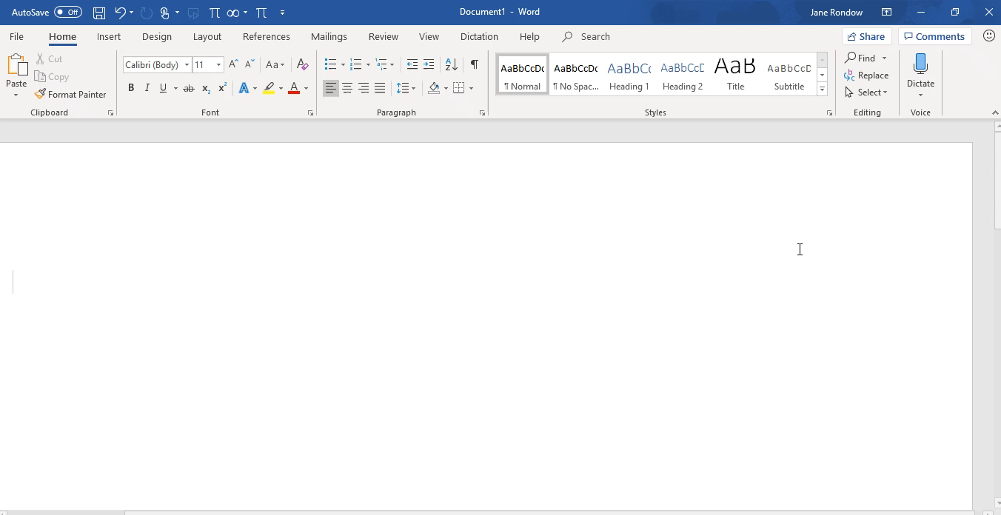

Slide 3
Links to Microsoft Math Support Documents and Videos - Word Desktop version
Insert mathematical symbols Tip
Inserting Equations Video
Converting Equations Video

