Slide 1
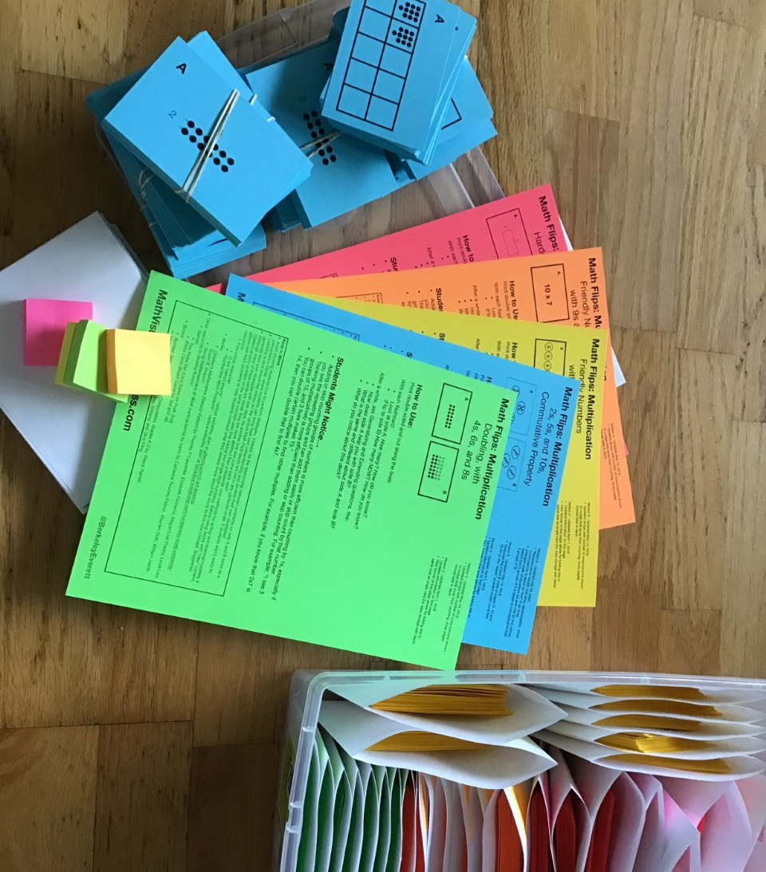
Math Flips
Multiplication
https://mathvisuals.wordpress.com/math-flips/
Notes:
https://mathvisuals.wordpress.com/math-flips/
Visit site for free downloads of all math flips

Slide 2
Introduction:
What do you notice about this deck?
What seems familiar to you?
What draws your attention?
What relationships do you notice between side A and side B?
Notes:
Although many of these cards are visual, they are more abstract than a students’ own methods for acting-out/drawing/modeling a contextual story problem of the same concept area (like adding two single-digit numbers). Before using decks with “new” content, please use story problems to help students connect what they already know about the world to this new concept.

Slide 3
Math Flips routine:
Look at side A: How many? How do you know?
Look at side B: How many NOW? How do you know?
After a while, ask generalizing questions such as: How does A help you solve B? What is the same and different about A and B?
Notes:
Math Flips are inspired by Chrissy Newell, who created a number talk with two related problems and the question sequence “How many? How do you know?” and “How many NOW? How do you know?”, Annie Fetter and Joe Schwartz, who say “Ask about ideas, not answers,”
How to Use: Print double sided and cut along the lines. With each flashcard: • Look at side A: How many? How do you know? • (Flip to side B) How many NOW? How do you know? After a while, ask Generalizing and Extending questions, like: • How does side A help you with side B? • What is the same and different about side A and side B? • What do you notice about this deck?

Slide 4
Multiplication Sets:
• 2s, 5s, and 10s with Commutative Property
• Doubling with 4s, 6s, and 8s https://mathvisuals.wordpress.com/multiplication-division/
• Friendly Numbers with 3s and 6s
• Friendly Numbers with 9s and 4s
• Hardest Facts
Notes:
How to Use: Print double sided and cut along the lines. With each flashcard: • Look at side A: How many? How do you know? • (Flip to side B) How many NOW? How do you know? After a while, ask Generalizing and Extending questions, like: • How does side A help you with side B? • What is the same and different about side A and side B? • What do you notice about this deck?

Slide 5
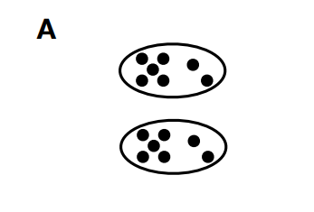
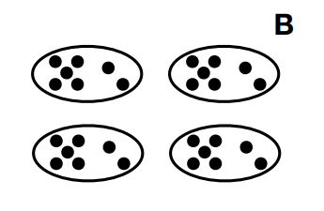
Notes:
https://mathvisuals.wordpress.com/multiplication-division/

Slide 6
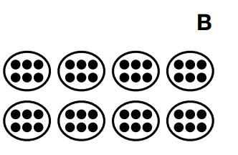
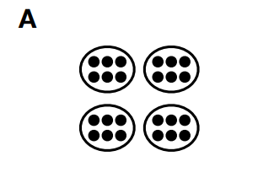

Slide 7
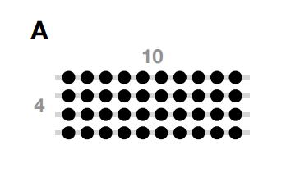

Slide 8
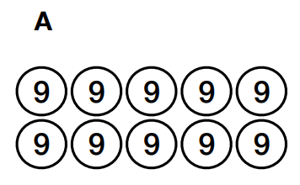
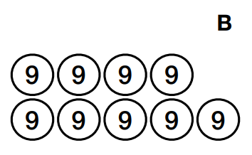

Slide 9
Something to keep in mind:
Avoid showing students how to perform strategies. Instead, let the relationship between problems on side A and B serve as a conversation starter, where students can bring their own understanding and develop their own strategies!

Slide 10
Students Might Notice…
• Adding or skip counting groups of numbers is more efficient than counting by 1s, especially if you see the repeating groups and can add them easily or skip count by that number.
• Thinking multiplicatively is more efficient than adding or skip counting. For example: “I see 3 groups of 15, and 3 fives makes 15.”
• Knowing a similar fact (a “friendly number”) can help you with more difficult problem. For example, if I know 3x7=21, I can think of 6x7 as double that, so 21 plus 21 makes 42.

Slide 11
